Slide 1
U.S. Political Parties From 1840 to 1860:
Whigs, Republicans, Know-Nothings, and Free Soil Movements
Notes:
---
This presentation examines the dynamic political landscape of the United States between 1840 and 1860, focusing on the rise and fall of key political parties including the Whigs, Republicans, Know-Nothings, and Free Soil movements.

Slide 2
The Political Landscape of the United States,
1840-1860
Notes:
During this period, America faced key issues such as slavery, territorial expansion, and states’ rights, which deeply influenced party politics and caused volatility as new parties emerged to address these concerns.

Slide 3
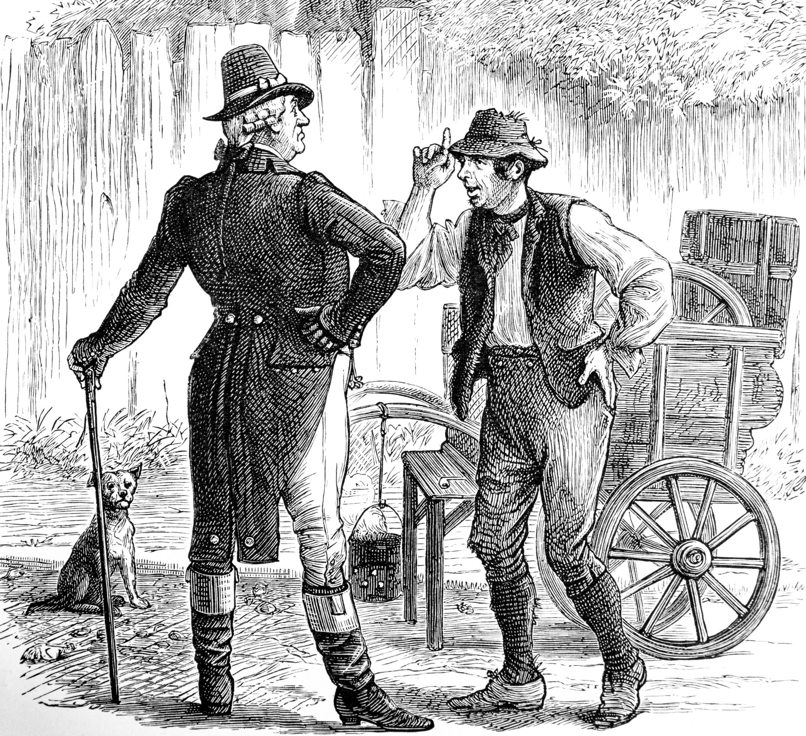
Overview of American Society and Issues in the Mid-19th Century
Rapid Growth and Expansion
  The mid-19th century experienced rapid population growth and westward expansion shaping American society.
Sectional Tensions
  Intensifying sectional tensions arose from differing regional interests and cultural divides.
Economic and Political Issues
  Economic transformations and slavery debates influenced public opinion and political alignments.
Notes:
---
American society was marked by rapid growth, westward expansion, and increasing sectional tensions. Economic changes and debates over slavery shaped public opinion and political alignments.
Image source: Microsoft 365 content library

Slide 4
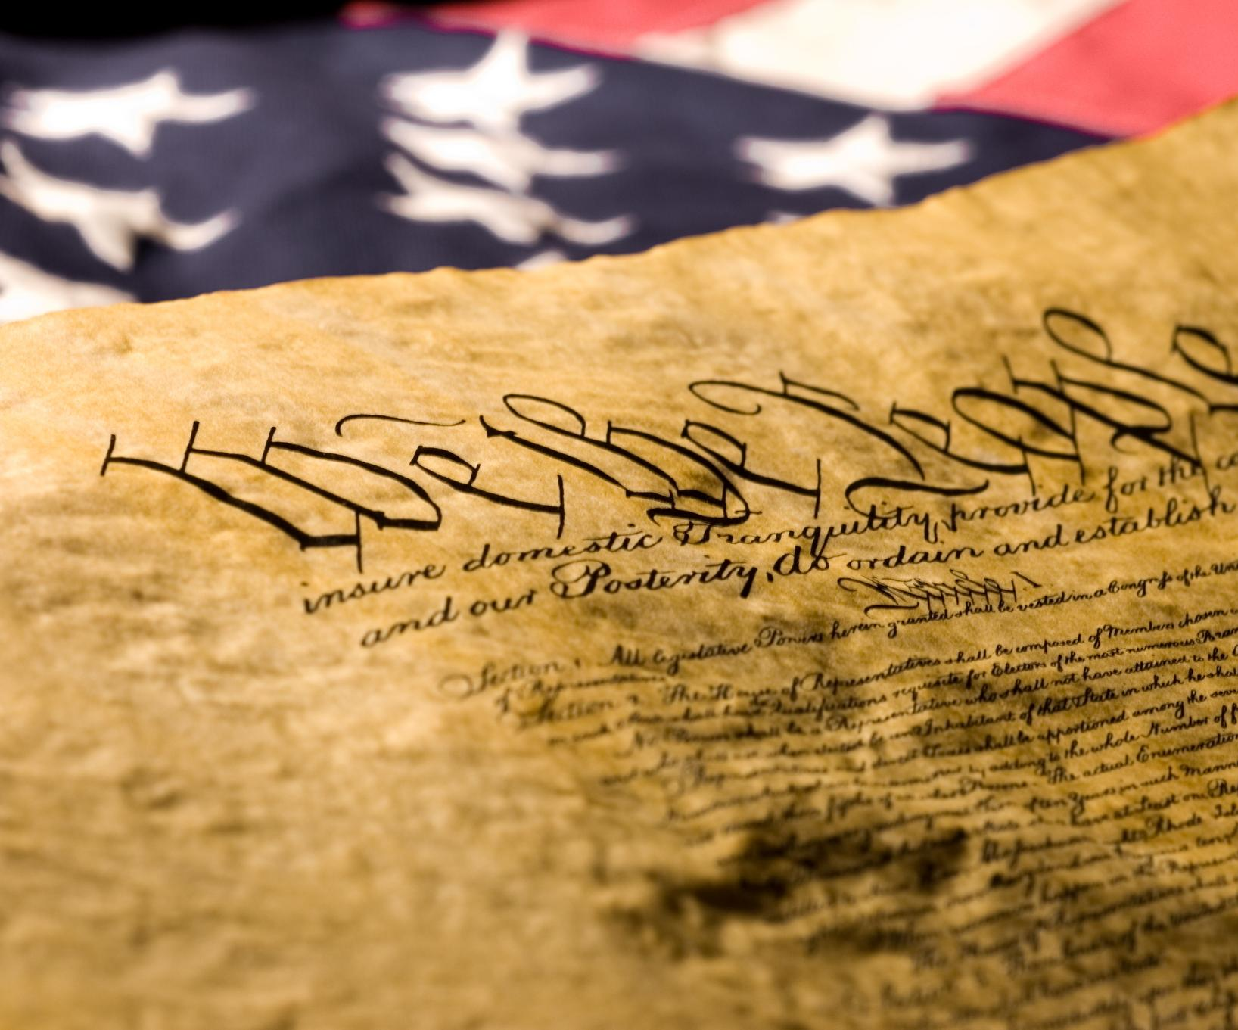
Major National Debates: Slavery, Expansion, and States’ Rights
Slavery Expansion Debate
  The nation grappled with whether slavery should spread into new territories, intensifying political divisions.
Federal vs State Power
  Disputes over the balance of power between federal and state governments shaped national policies and tensions.
Moral and Economic Implications
  Slavery's moral controversies and economic significance fueled passionate national debate and political discourse.
Notes:
---
Debates over the expansion of slavery into new territories, the balance of power between federal and state governments, and the moral and economic implications of slavery dominated political discourse.
Image source: Microsoft 365 content library

Slide 5

Transformation and Volatility in Party Politics
Party System Upheaval
  Traditional parties fractured, causing major shifts in the political landscape and disrupting established power structures.
Emergence of New Movements
  New political movements arose, reflecting sectional interests and ideological divides within the nation.
Sectional and Ideological Divides
  Deepening divisions between regions and ideologies drove realignment in party politics and voter bases.
Notes:
---
The political system experienced upheaval as traditional parties like the Democrats and Whigs fractured, giving rise to new movements and realignments driven by sectional and ideological divides.
Image source: Microsoft 365 content library

Slide 6
The Whig Party:
Philosophy and
Decline
Notes:
The Whig Party played a central role in early 19th-century politics but eventually declined due to internal divisions and national conflicts over slavery and expansion.

Slide 7
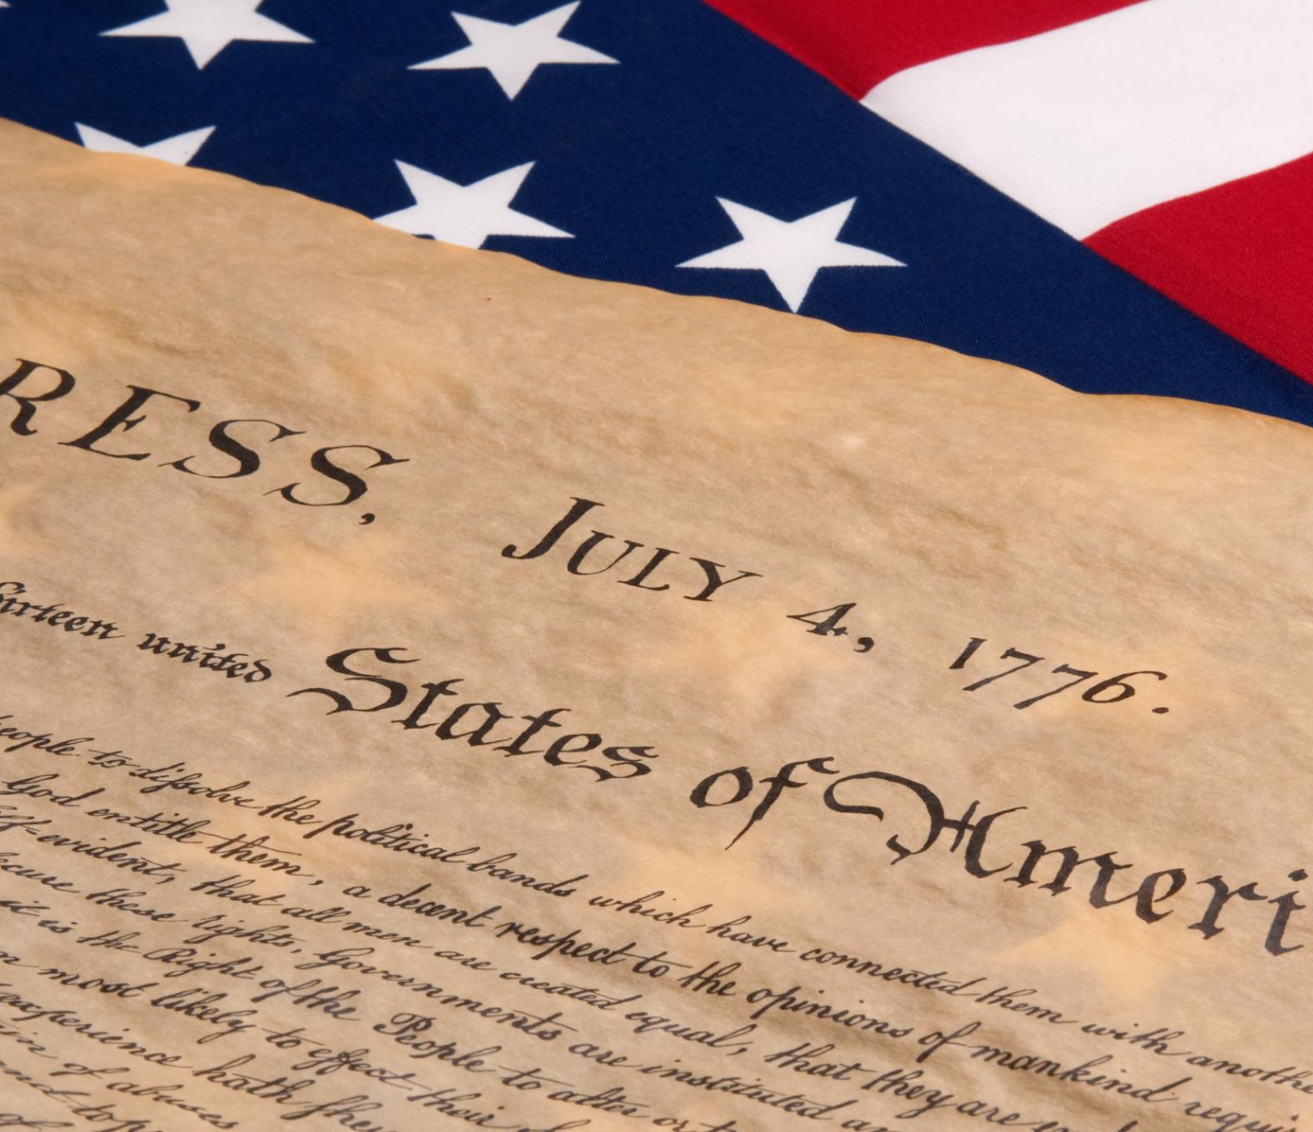
Origins and Core Principles of the Whig Party
Formation Against Jackson Clay, Webster, Calhoun
  The Whig Party formed primarily to oppose Andrew Jackson’s policies and presidential style.
Strong Federal Government
  Whigs supported a robust federal government to guide national growth and policy.
Economic Modernization
  The party promoted economic modernization including industry, banking, and infrastructure development.
Internal Improvements
  Whigs supported federal funding for internal improvements like roads, canals, and railroads.
Notes:
---
Formed in opposition to Andrew Jackson’s policies, the Whigs advocated for a strong federal government, economic modernization, and internal improvements.
Image source: Microsoft 365 content library

Slide 8

Key Whig Leaders and Electoral Successes
Whig Party Leadership
  Henry Clay and Daniel Webster were prominent leaders shaping the Whig Party's policies and direction during its peak.
Presidential Victories
  The Whig Party won presidential elections with candidates William Henry Harrison and Zachary Taylor, marking significant electoral success.
Notes:
---
Prominent figures such as Henry Clay and Daniel Webster led the party, which achieved presidential victories with candidates like William Henry Harrison and Zachary Taylor.
Image source: Microsoft 365 content library

Slide 9

Factors Leading to the Collapse of the Whigs
Slavery Division
  The Whig party split due to unresolved conflicts over the slavery issue between northern and southern members.
Reconciliation Failure
  Inability to reconcile differences on slavery led to the party's disintegration by the late 1850s.
Notes:
---
The party fractured over the slavery issue, with southern and northern Whigs unable to reconcile their differences, leading to its eventual disintegration by the late 1850s.
Image source: Microsoft 365 content library

Slide 10
Emergence of New Political Movements
Notes:
New parties emerged to address issues that the old parties failed to solve, particularly around slavery and immigration, reshaping the political landscape before the Civil War.

Slide 11
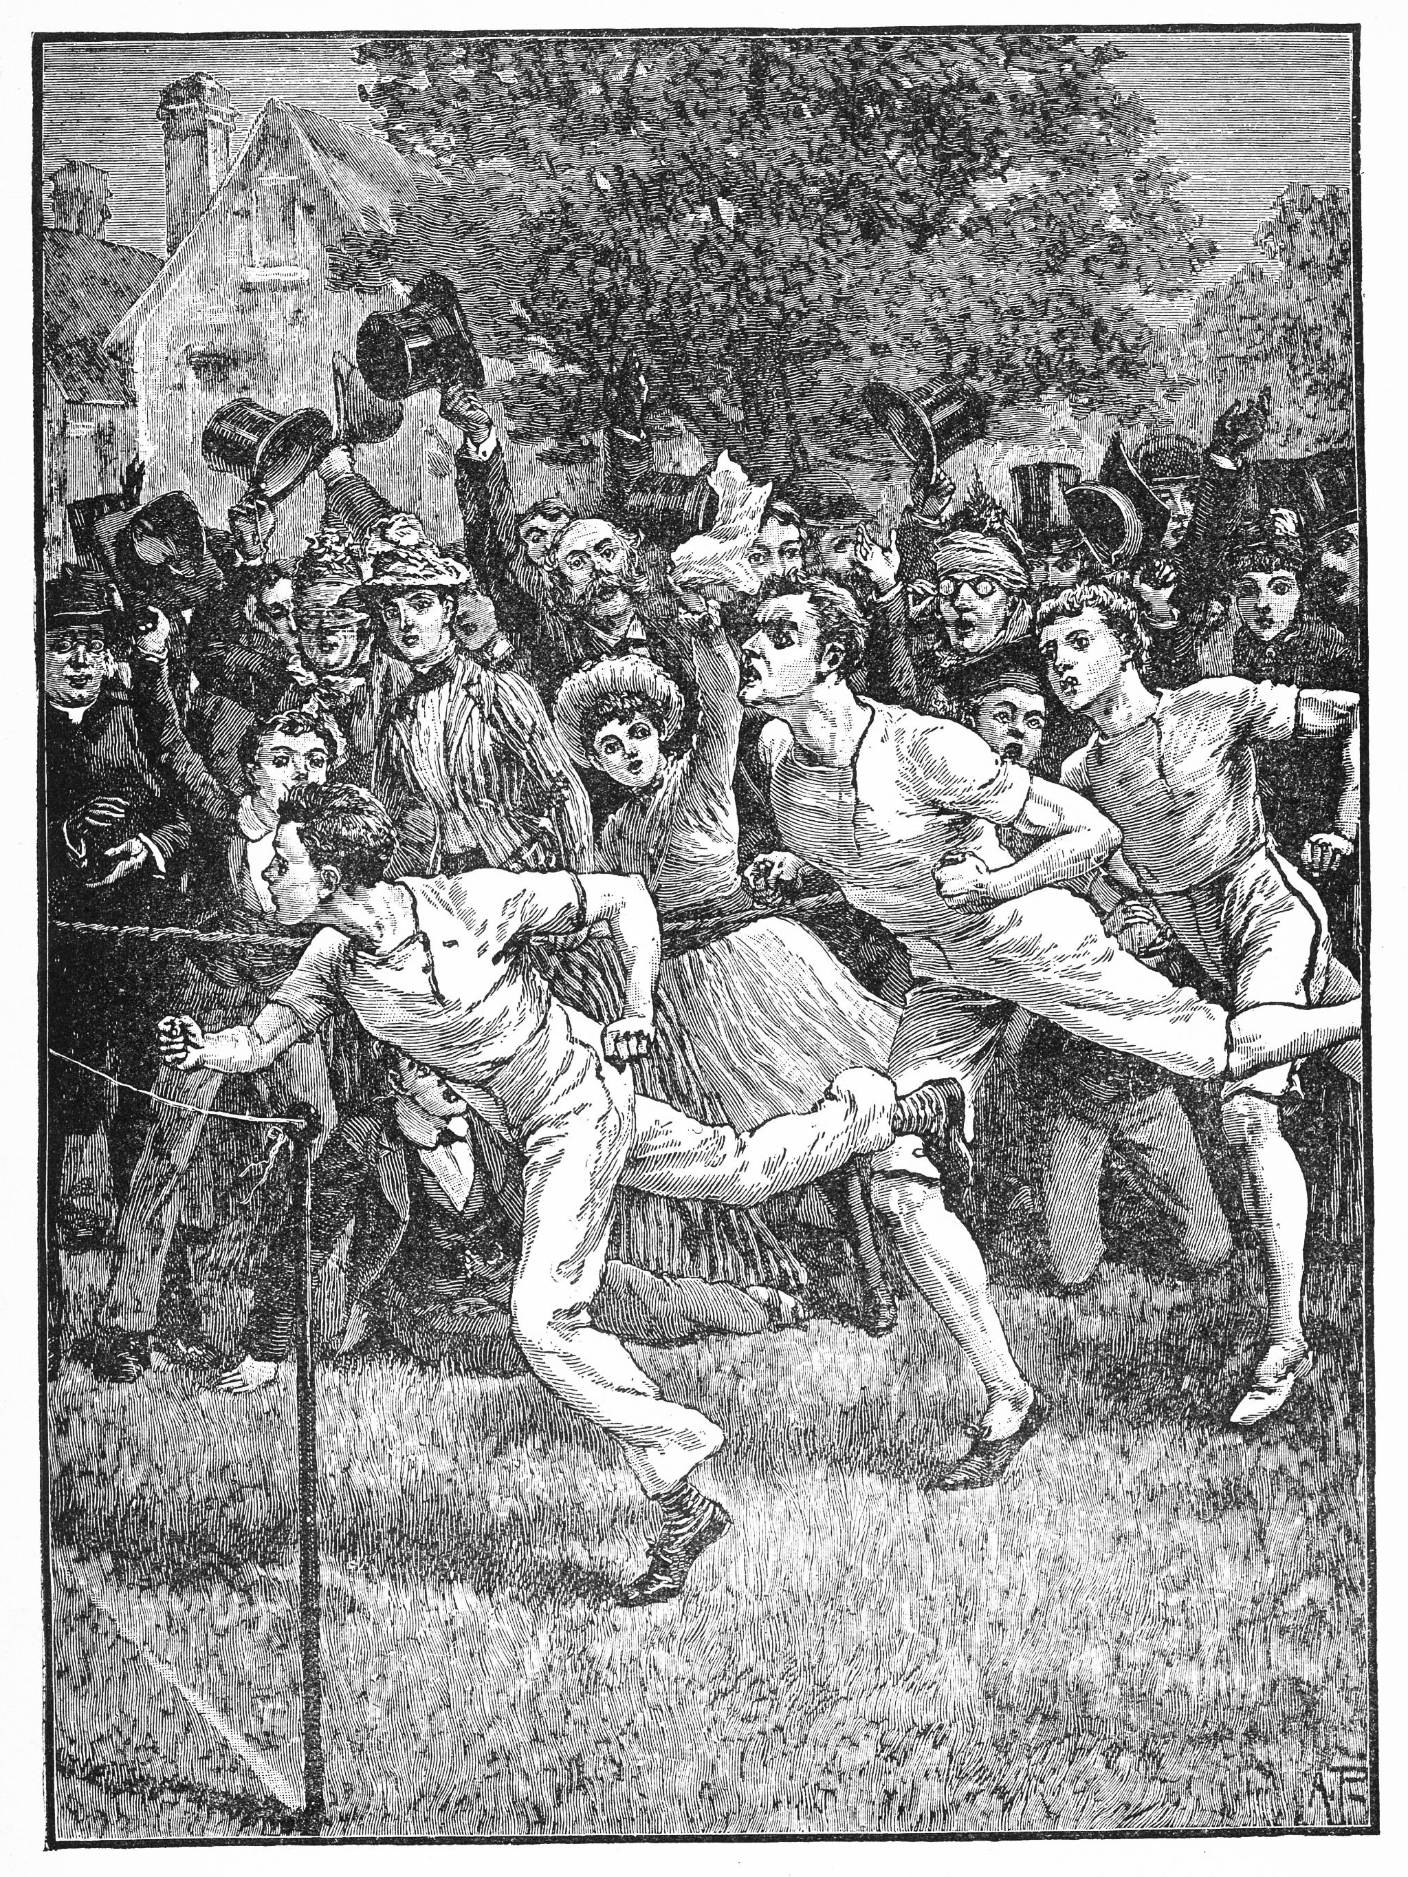
Rise of the Free Soil Party and Its Anti-Slavery Platform
Opposition to Slavery Expansion
  The Free Soil Party actively opposed the spread of slavery into new western territories, shaping political discourse.
Attraction of Anti-Slavery Advocates
  The party attracted supporters who were committed to preventing slavery's growth despite their limited electoral victories.
Influence on National Debate
  Despite limited success at the polls, the Free Soil Party significantly influenced the national conversation on slavery.
Notes:
---
The Free Soil Party opposed the expansion of slavery into western territories, attracting anti-slavery advocates and influencing national debate despite limited electoral success.
Image source: Microsoft 365 content library

Slide 12
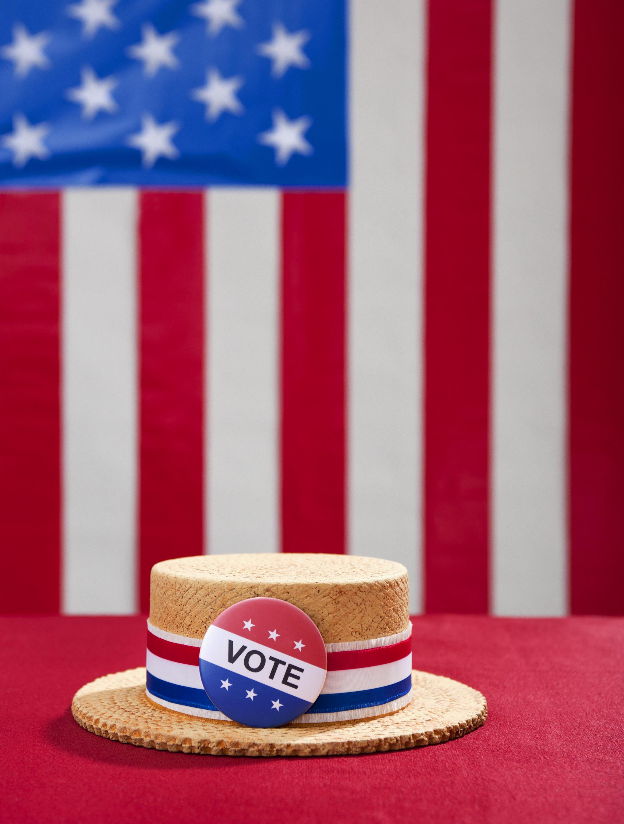
The Political Influence and Eventual Decline of These Movements
Short-Term Political Influence
  The Free Soil and Know-Nothing parties significantly influenced political debates in their brief existence.
Absorption by Larger Parties
  Issues championed by these parties were eventually absorbed by larger parties, especially the Republican Party.
Decline and Dissolution
  Both parties declined as their unique issues lost distinct political identity within major parties.
Notes:
---
Although influential in the short term, both the Free Soil and Know-Nothing parties declined as their issues were absorbed by larger parties, particularly the emerging Republican Party.
Image source: Microsoft 365 content library

Slide 13
The Republican Party:
Rise and Realignment
Notes:
The Republican Party quickly rose in the 1850s as a major political force opposing slavery’s expansion and advocating for national growth, significantly impacting the 1860 election.

Slide 14
Origins and Founding Members of the Republican Party
Formation from Multiple Factions
The Republican Party was formed by uniting former Whigs, Free Soilers, and anti-slavery Democrats into one political group.
Anti-Slavery Platform
The party’s key platform was opposing the expansion of slavery into new territories and states.
Political Unity
The Republican Party united different factions with shared political goals in the mid-19th century America.
Notes:
---
Formed from former Whigs, Free Soilers, and anti-slavery Democrats, the Republican Party united various factions under a platform opposing the spread of slavery.
Image source: Microsoft 365 content library

Slide 15

Republican Positions on Slavery & National Growth
Opposition to Slavery Expansion
  The party focused on preventing the spread of slavery into new territories and states.
Economic Development Support
  Promoted policies to foster national economic growth through industry and commerce.
Infrastructure and Free Labor
  Supported infrastructure projects and upheld ideals of free labor over slavery.
Notes:
---
The party advocated for preventing slavery's expansion, promoting economic development, and supporting infrastructure and free labor ideals.
Image source: Microsoft 365 content library

Slide 16
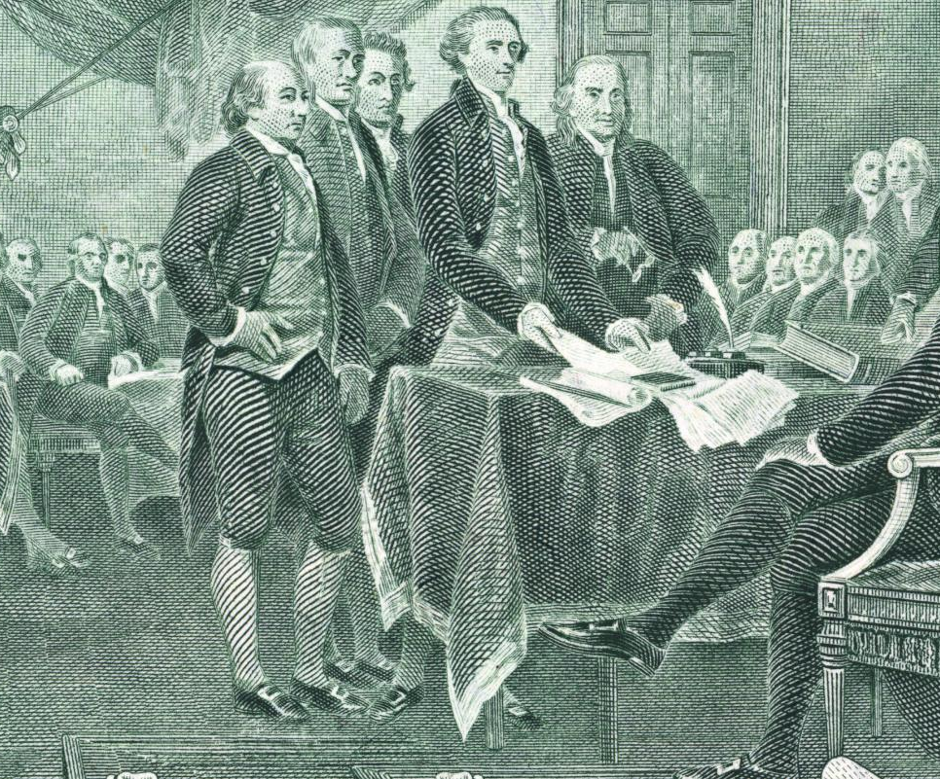
Impact of the Republican Party on the 1860 Election
Republican Party's Rise
  The Republican Party emerged as a major political force in 1860 leading to Abraham Lincoln's historic election as president.
Secession Crisis Trigger
  Lincoln's election intensified sectional tensions, triggering southern states to secede from the Union.
Civil War Prelude
  The 1860 election set the stage for the American Civil War, fundamentally reshaping the nation’s future.
Notes:
---
The election of Abraham Lincoln as the first Republican president in 1860 marked a pivotal shift in U.S. politics, contributing to the secession crisis and the Civil War.
Image source: Microsoft 365 content library

Slide 17
Conclusion
Political Party Transformations
From 1840 to 1860, American political parties changed significantly due to growing sectional and ideological tensions.
Sectional Tensions Impact
Regional conflicts deeply influenced party dynamics and contributed to escalating divisions within the nation.
Path to Civil War
The rise and fall of political parties during this period set the foundation for the outbreak of the Civil War.
Notes:
Between 1840 and 1860, American political parties underwent significant transformations shaped by sectional tensions and ideological conflicts. The era set the stage for the Civil War, with the rise and fall of parties reflecting the nation's deep divisions.

Slide 18
The Know Nothing Political Party: America's Nativist Movement of the Mid-1800s
Origins and impact of 19th-century nativist politics
Notes:
---
This presentation explores the Know Nothing Party, a significant political movement in mid-19th century America characterized by its nativist ideology and opposition to immigration, especially Catholic immigrants. We will examine its origins, beliefs, leadership, and lasting impact on American politics.

Slide 19

Rise of Nativism and Anti-Immigrant Sentiment
Growth of Nativism
  Nativism intensified due to fears that immigrants endangered traditional cultural values and economic stability.
Economic and Political Fears
  Many Americans worried immigrants would take jobs and reduce their political influence.
Hostility Toward Catholic Immigrants
  Catholic immigrants faced prejudice and suspicion during the rise of nativist sentiment.
Notes:
---
Nativism grew as many Americans feared that immigrants threatened traditional values, jobs, and political power. This led to widespread hostility toward Catholic immigrants, who were often viewed with suspicion and prejudice.
Image source: Microsoft 365 content library

Slide 20
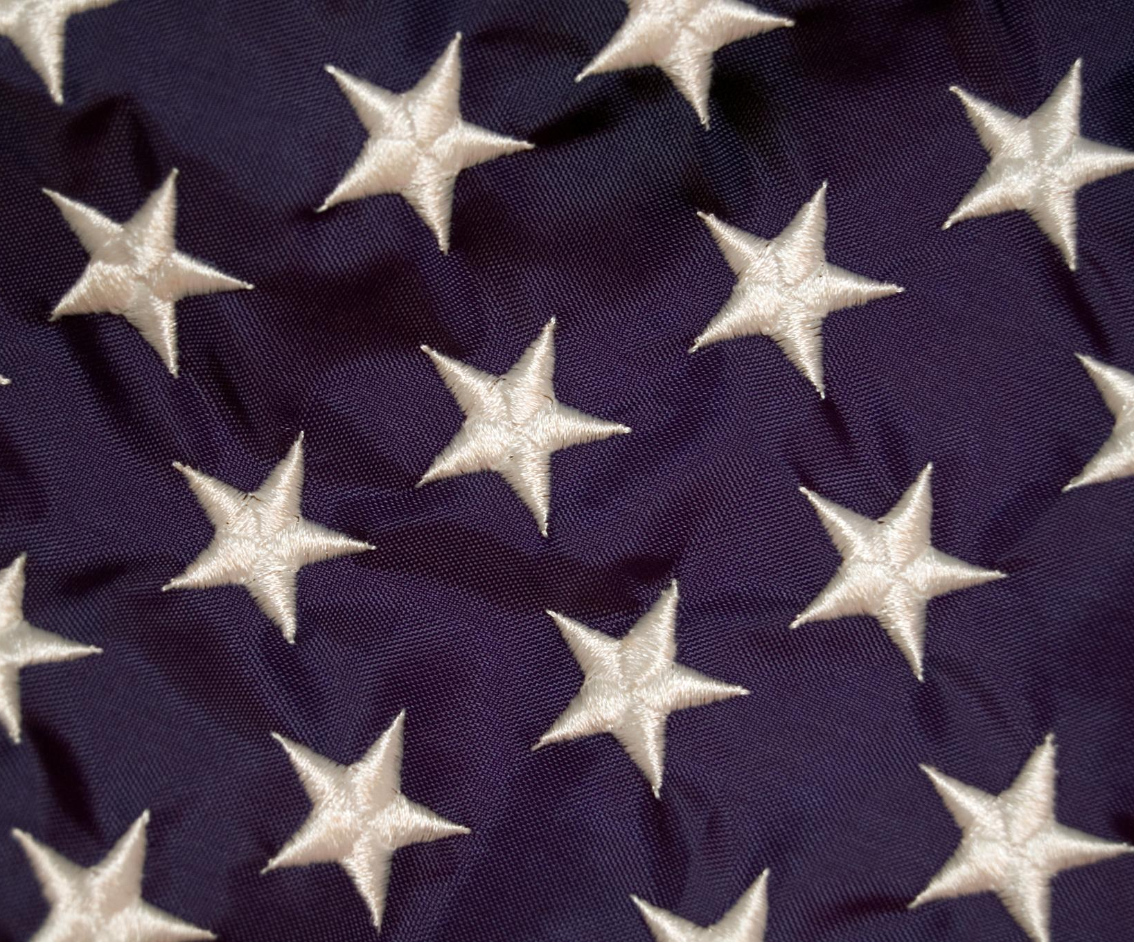
Core Principles and Ideology
Preservation of Traditional Values
  The party emphasized maintaining Protestant American cultural and social values as a core principle.
Restricting Immigrant Influence
  Limiting the influence of immigrants was a key part of the party's ideology to protect national identity.
Loyalty and Sovereignty
  The party promoted loyalty to the United States and opposed foreign interference in domestic politics.
Notes:
---
The party advocated for the preservation of Protestant American values and sought to limit immigrant influence. They emphasized loyalty to the United States and opposed foreign interference in politics.
Image source: Microsoft 365 content library

Slide 21
Key Leaders and Prominent Figures
Influential Political Leaders
  Key leaders like Millard Fillmore played a significant role in advancing the party's popularity through experienced leadership.
Advocacy for Nativist Policies
  Leaders strongly advocated for nativist policies, shaping the party's political stance and public support.
Notes:
---
Leaders such as Millard Fillmore and other politicians helped popularize the party. Their leadership combined political experience with strong advocacy for nativist policies.
Image source: Microsoft 365 content library

Slide 22
Structure and Methods of Secrecy
Secret Rituals
The group used secret rituals to strengthen internal bonds and maintain confidentiality among members.
Coded Communication
Members communicated using special codes and phrases to prevent revealing information externally.
Secrecy Preservation
Members responded with 'I know nothing' to questions, ensuring secrecy and protecting the group’s identity.
Notes:
---
The party operated with secret rituals, codes, and oaths. Members were instructed to respond with 'I know nothing' when questioned, which gave the party its popular name and preserved secrecy.
Image source: Microsoft 365 content library

Slide 23
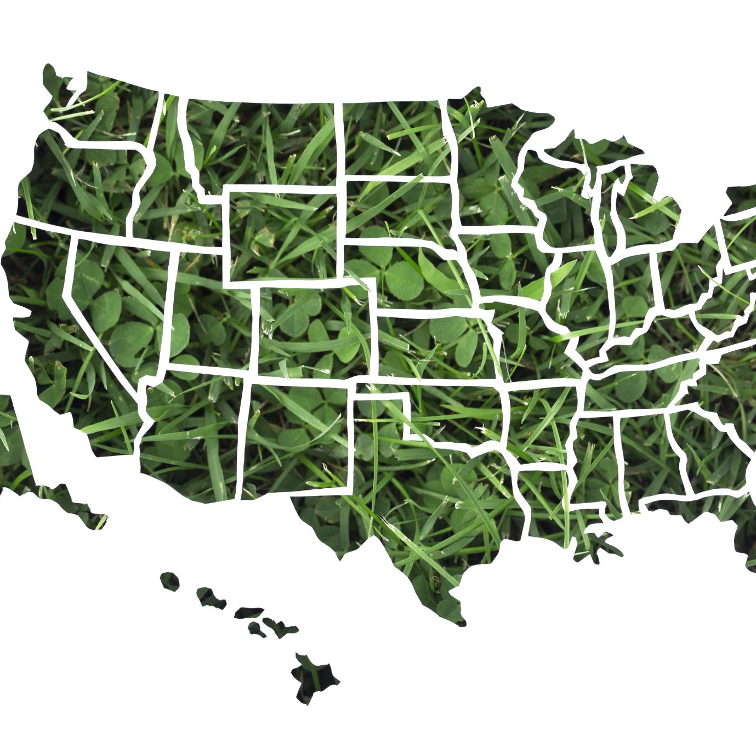
Demographics and Geographic Distribution of Support
Core Support Base
  The party primarily attracted native-born Protestants forming its core support.
Geographic Concentration
  Support was strong in urban centers of the Northeast and parts of the Midwest regions.
Socioeconomic Profile
  The base mainly consisted of middle-class citizens concerned about immigration effects.
Notes:
---
The party drew support mainly from native-born Protestants, especially in urban centers of the Northeast and parts of the Midwest. Their base tended to be middle-class citizens concerned about immigration's impact.
Image source: Microsoft 365 content library

Slide 24
Influence, Decline, and Legacy of the Know Nothing Party
Notes:
Despite early electoral successes, the party declined due to internal divisions and the rise of the Civil War. However, its legacy influenced future nativist movements and American political discourse.

Slide 25
Electoral Successes and Failures
Local and State Victories
The party secured important local and state-level wins throughout the 1850s, building regional influence.
Congressional Representation
The party elected members to Congress, marking notable political success during this period.
Limited National Impact
Despite regional wins, the party failed to gain lasting national dominance in the political landscape.
Notes:
---
The party achieved significant local and state-level victories during the 1850s, even electing some members to Congress, but failed to establish long-term national dominance.
Image source: Microsoft 365 content library

Slide 26
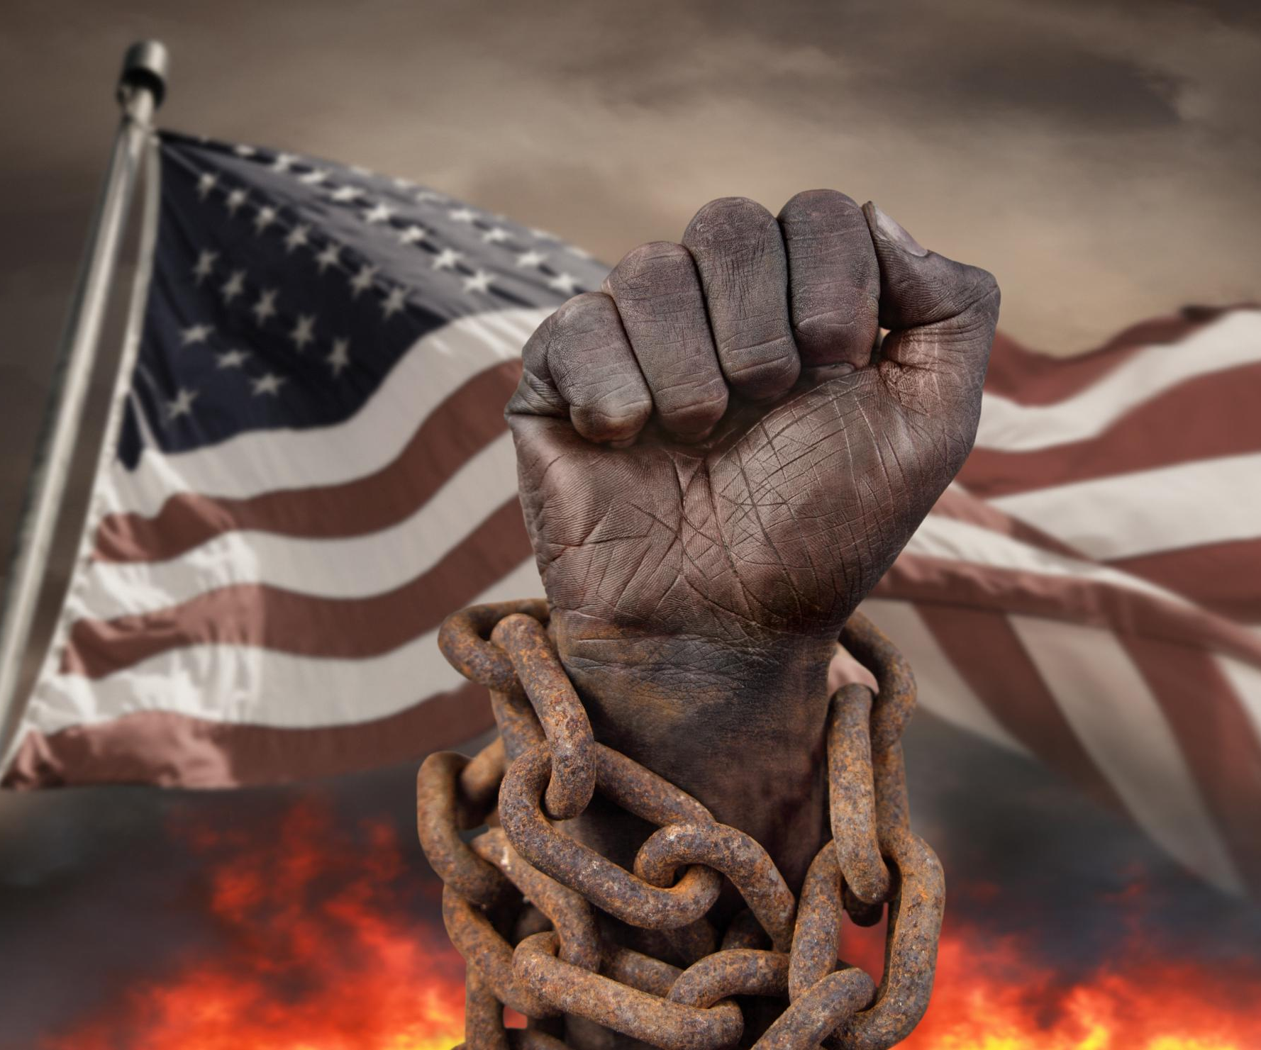
Reasons for the Party's Decline
Internal Conflicts
  Internal conflicts weakened party unity and diminished its political effectiveness significantly.
Slavery Issue
  The party failed to effectively address slavery, a critical national issue dividing the country.
Civil War Outbreak
  The Civil War outbreak accelerated the party’s decline and led to its eventual dissolution.
Notes:
---
Internal conflicts, inability to address pressing national issues like slavery, and the outbreak of the Civil War led to the party's rapid decline in influence and eventual dissolution.
Image source: Microsoft 365 content library

Slide 27
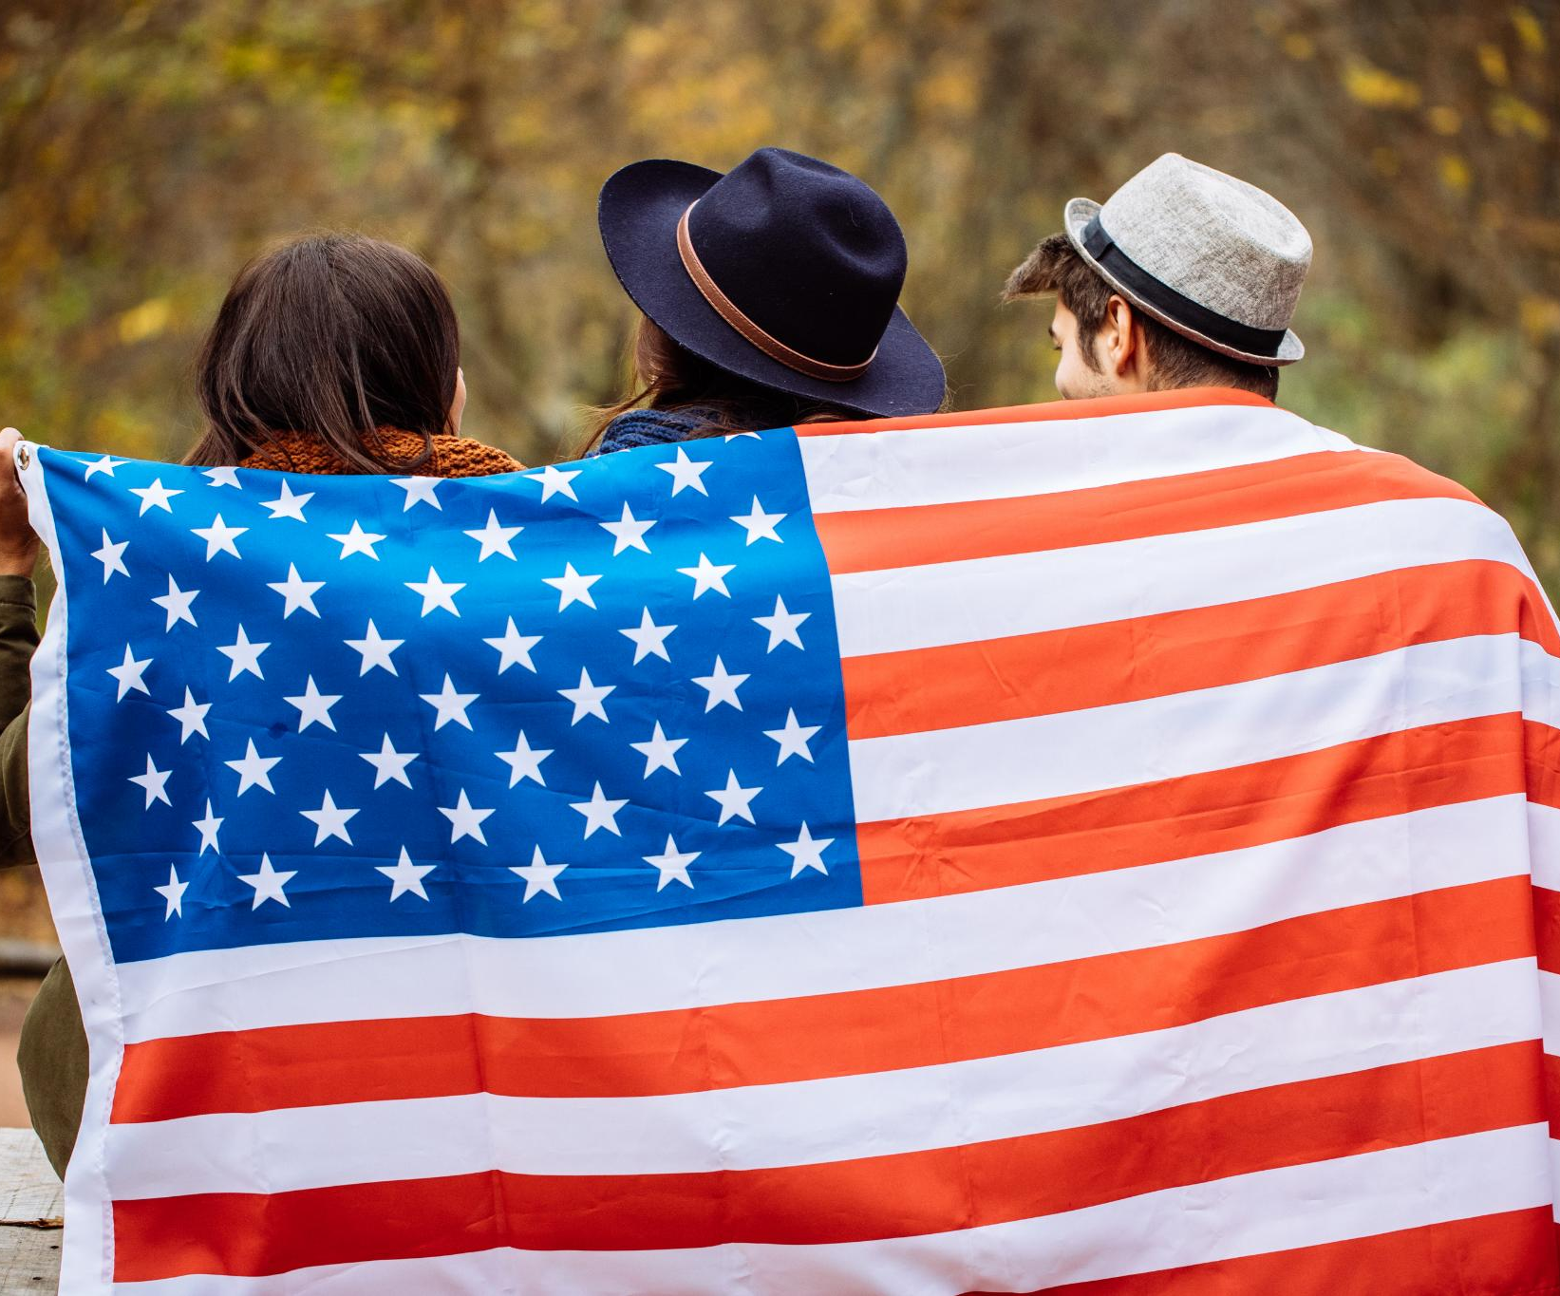
Long-Term Impact on American Politics and Society
Foundation of Nativism
  The Know Nothing movement established early anti-immigrant sentiments influencing future political ideologies in America.
Influence on Immigration Policy
  The movement shaped immigration policies by highlighting political power of anti-immigrant attitudes in society.
Debates on Identity and Citizenship
  It influenced ongoing debates about national identity, citizenship rights, and inclusion in American society.
Notes:
---
The Know Nothing movement laid the foundation for later nativist sentiments and influenced immigration policies. It demonstrated the political power of anti-immigrant attitudes and shaped debates on identity and citizenship.
Image source: Microsoft 365 content library

Slide 28
1840’s – 1860’s
Political Landscale
Notes:
---
This presentation examines the dynamic political landscape of the United States between 1840 and 1860, focusing on the rise and fall of key political parties including the Whigs, Republicans, Know-Nothings, and Free Soil movements.

