Slide 1
The Democratic-Republican Party: History, Founders, and Leadership
Exploring the origins and influence of early politics
Notes:
---
This presentation covers the history and significance of the Democratic-Republican Party, one of the first political parties in the United States. We will explore its origins, prominent founders, notable presidents, vice presidents, and its lasting impact on American political thought.

Slide 2
Agenda Overview
Origins and Formation of the Democratic-Republican Party
Prominent Founders of the Democratic-Republican Party
US Presidents From the Democratic-Republican Party
Vice Presidents From the Democratic-Republican Party
Legacy and Impact of the Democratic-Republican Party
Notes:
We will begin by examining the origins and formation of the Democratic-Republican Party, discussing the historical context and its founding principles. Next, we will highlight the prominent figures who played crucial roles in its establishment. Following that, we will look at the U.S. Presidents and Vice Presidents from this party. Finally, we will analyze the party's legacy and its influence on American politics.

Slide 3
Origins and Formation of the Democratic-Republican Party
Notes:
The Democratic-Republican Party emerged in the early 1790s as a response to the Federalist Party. It sought to represent the interests of the agrarian population and maintain a strict interpretation of the Constitution.

Slide 4
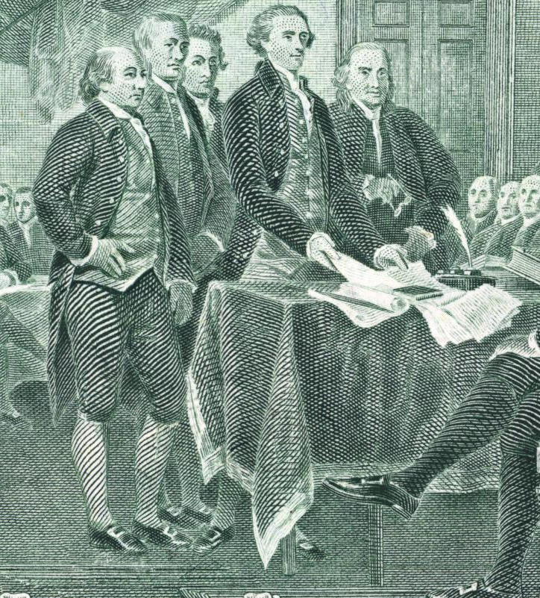
Historical Context and Political Landscape
Federalism vs. Anti-Federalism
  The late 18th century saw intense debates between Federalists and Anti-Federalists about the distribution of governmental power.
Formation of Political Parties
  The tensions from these debates eventually led to the formation of the Democratic-Republican Party, shaping the future of American politics.
Impact on Governance
  This critical period influenced the role of government and the principles of federalism that govern the United States today.
Notes:
The late 18th century marked a critical period in American politics, characterized by debates over federalism and the role of government. The tensions between the Federalists and Anti-Federalists set the stage for the formation of the Democratic-Republican Party.

Slide 5
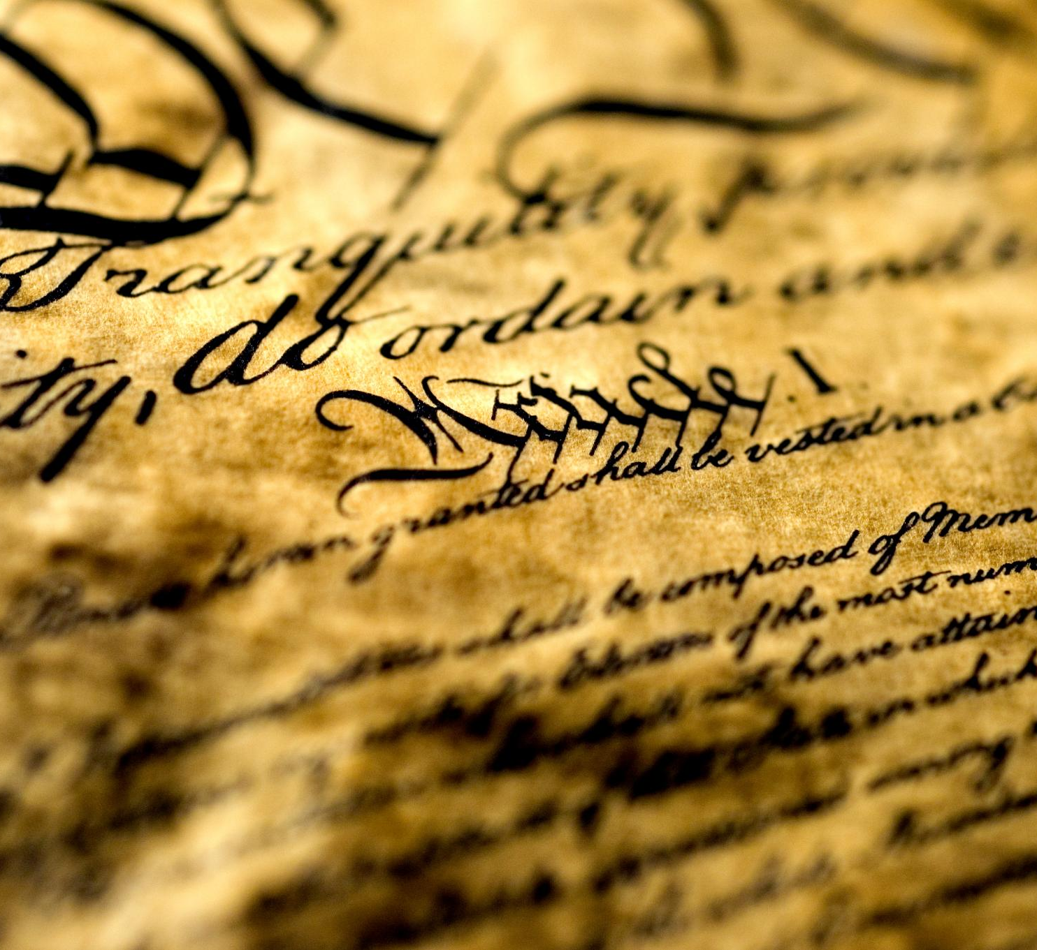
Founding Principles and Ideologies
States' Rights
  The Democratic-Republican Party emphasized the rights of individual states, advocating for local governance over federal control.
Agrarianism
  The party's ideology was rooted in agrarianism, promoting agriculture as the backbone of the economy and society.
Strict Interpretation of the Constitution
  Members believed in a strict interpretation of the Constitution, advocating for limited government powers.
Protection of Individual Liberties
  The party sought to protect individual liberties against government overreach, championing personal freedoms.
Notes:
The Democratic-Republican Party was founded on principles such as states' rights, agrarianism, and a strict interpretation of the Constitution. Its ideology favored limited government and the protection of individual liberties.

Slide 6
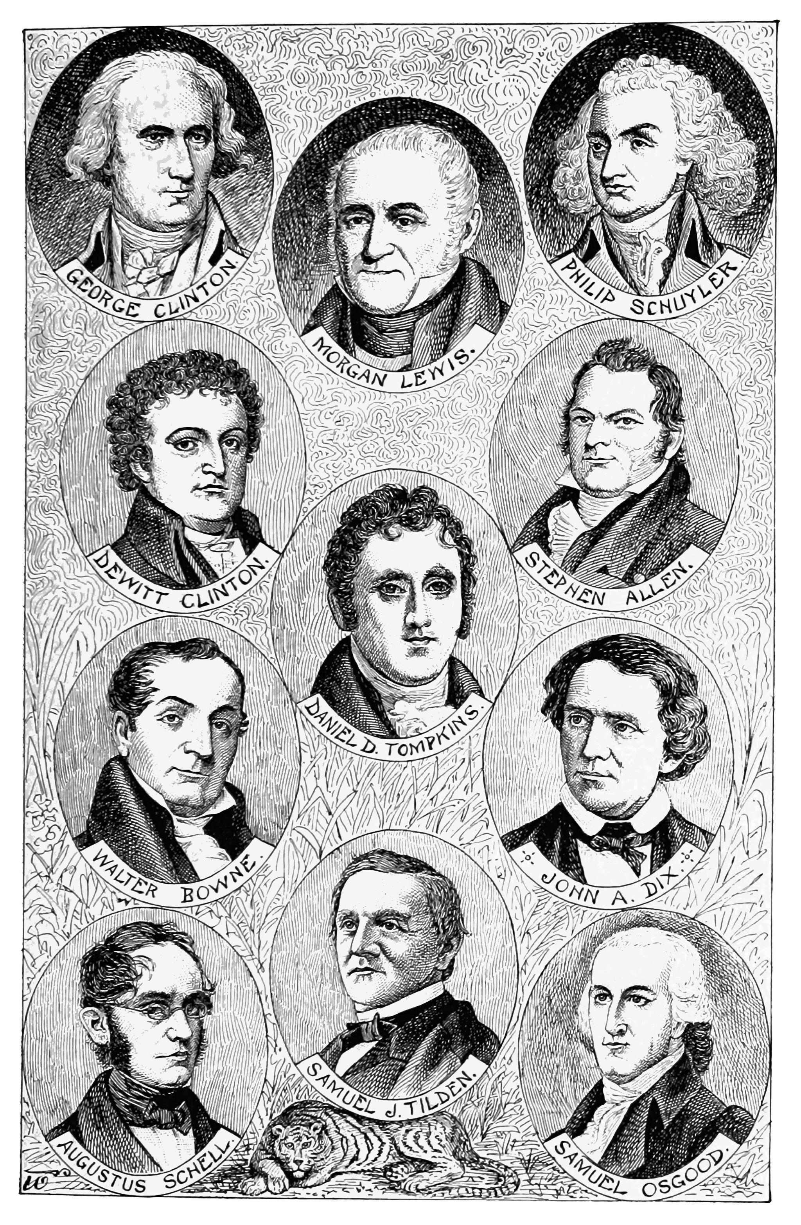
Formation and Early Years
Coalition of Groups
  The Democratic-Republican Party was formed as a coalition of various groups seeking to represent rural interests.
Popularity Among Farmers
  The party quickly gained traction among farmers and rural citizens, becoming their political voice and advocate.
Significant Political Shift
  The party's rise marked a significant shift in American politics, particularly during the pivotal 1800 election.
Notes:
Initially formed as a coalition of various groups, the Democratic-Republican Party quickly gained popularity among farmers and rural citizens. It became a formidable political force during the 1800 election, marking a significant shift in American politics.

Slide 7
Prominent Founders of the Democratic-Republican Party
Notes:
Key figures in the founding of the Democratic-Republican Party were influential leaders who shaped its direction and policies. Their contributions have left a lasting mark on the party's legacy.

Slide 8

Thomas Jefferson: Life and Contributions
Declaration of Independence
  Thomas Jefferson was the principal author of the Declaration of Independence, advocating for freedom and self-governance.
Democratic-Republican Party
  Jefferson was a leading figure in the Democratic-Republican Party, promoting a vision of democracy and civic rights.
Vision for America
  Jefferson emphasized democracy, individual rights, and agrarianism, shaping the ideals of the young nation.
Notes:
Thomas Jefferson, the principal author of the Declaration of Independence, was a leading figure in the Democratic-Republican Party. His vision for America emphasized democracy, individual rights, and agrarianism.

Slide 9
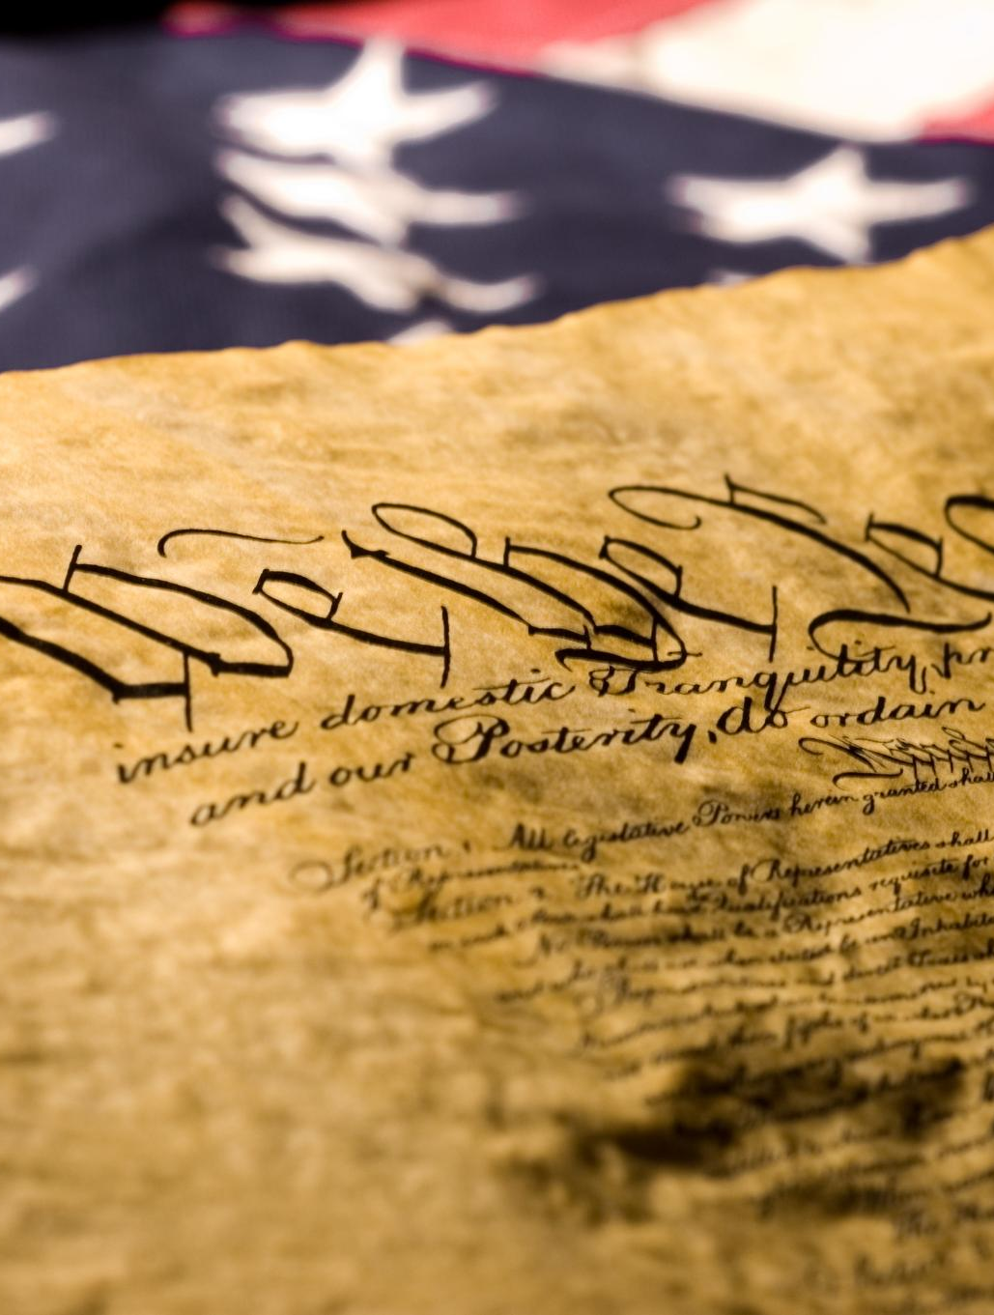
James Madison: Life and Contributions
Father of the Constitution
  James Madison is often referred to as the 'Father of the Constitution' due to his pivotal role in its drafting and promotion.
Democratic-Republican Party
  Madison was instrumental in the formation of the Democratic-Republican Party, which advocated for states' rights and agrarian interests.
Federalism and Checks and Balances
  His emphasis on federalism and checks and balances has had a lasting impact on American governance and political structure.
Notes:
James Madison, known as the 'Father of the Constitution,' played a vital role in the formation of the Democratic-Republican Party. His focus on federalism and checks and balances influenced the party's principles.

Slide 10

Other Key Figures and Supporters
Albert Gallatin's Contributions
  Albert Gallatin played a crucial role in shaping the party's fiscal policies and advocating for economic growth.
John Dickinson's Support
  John Dickinson was instrumental in supporting the party's formation and promoting its agenda through his writings.
Notes:
In addition to Jefferson and Madison, several other leaders and supporters contributed to the party's formation. Figures such as Albert Gallatin and John Dickinson helped advance the party's agenda.

Slide 11
US Presidents From the Democratic-Republican Party
Notes:
The Democratic-Republican Party produced several influential U.S. Presidents who shaped the early years of the nation. Their leadership had a profound impact on American governance.

Slide 12

Thomas Jefferson's Presidency (1801-1809)
Louisiana Purchase
  The Louisiana Purchase in 1803 doubled the size of the United States, significantly expanding its territory and resources.
Lewis and Clark Expedition
  The Lewis and Clark Expedition, established under Jefferson, explored the newly acquired territory and mapped routes to the Pacific Ocean.
Notes:
Jefferson's presidency marked significant developments, including the Louisiana Purchase and the establishment of the Lewis and Clark Expedition, which expanded U.S. territory and influence.

Slide 13
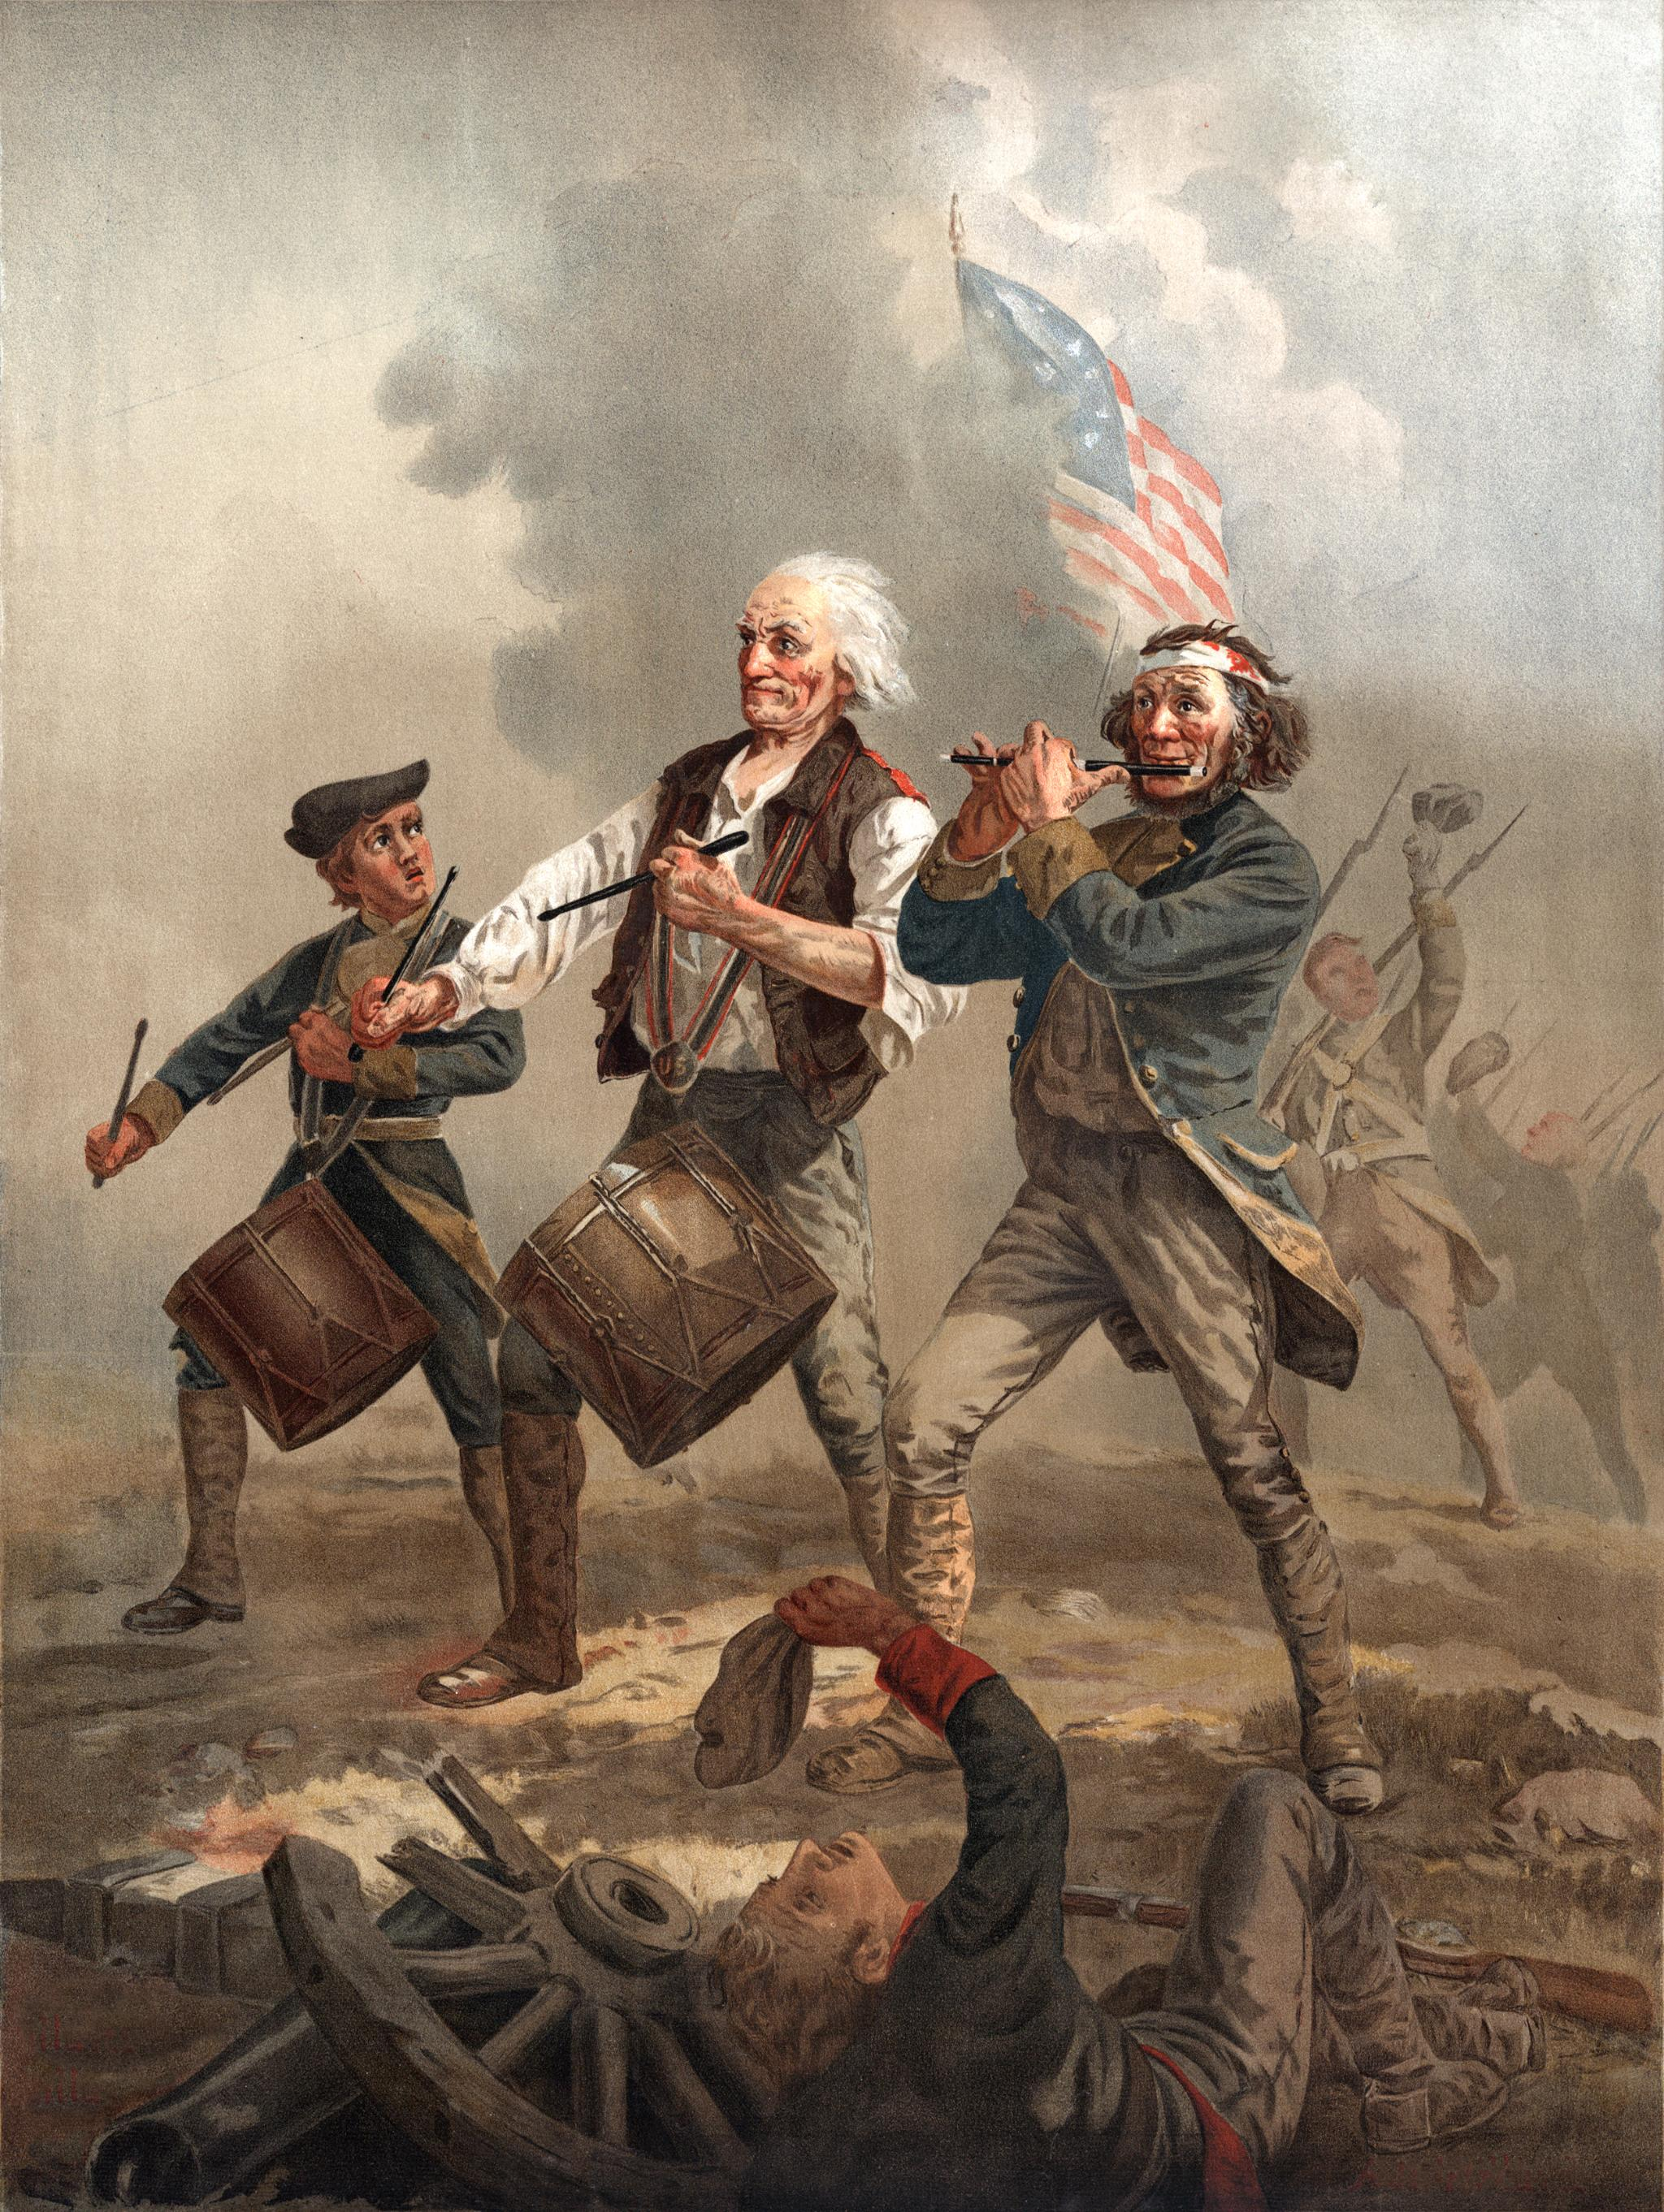
James Madison's Presidency (1809-1817)
War of 1812
  The War of 1812 was a significant conflict during Madison's presidency, testing the resilience of the young United States.
National Sovereignty
  Madison's leadership emphasized national sovereignty, focusing on the importance of defending American independence during wartime.
Resilience of the Nation
  The challenges faced during Madison's presidency highlighted the resilience and determination of the early American republic.
Notes:
Madison's presidency was characterized by the War of 1812, a conflict that tested the resilience of the young nation and emphasized the party's focus on national sovereignty and defense.

Slide 14
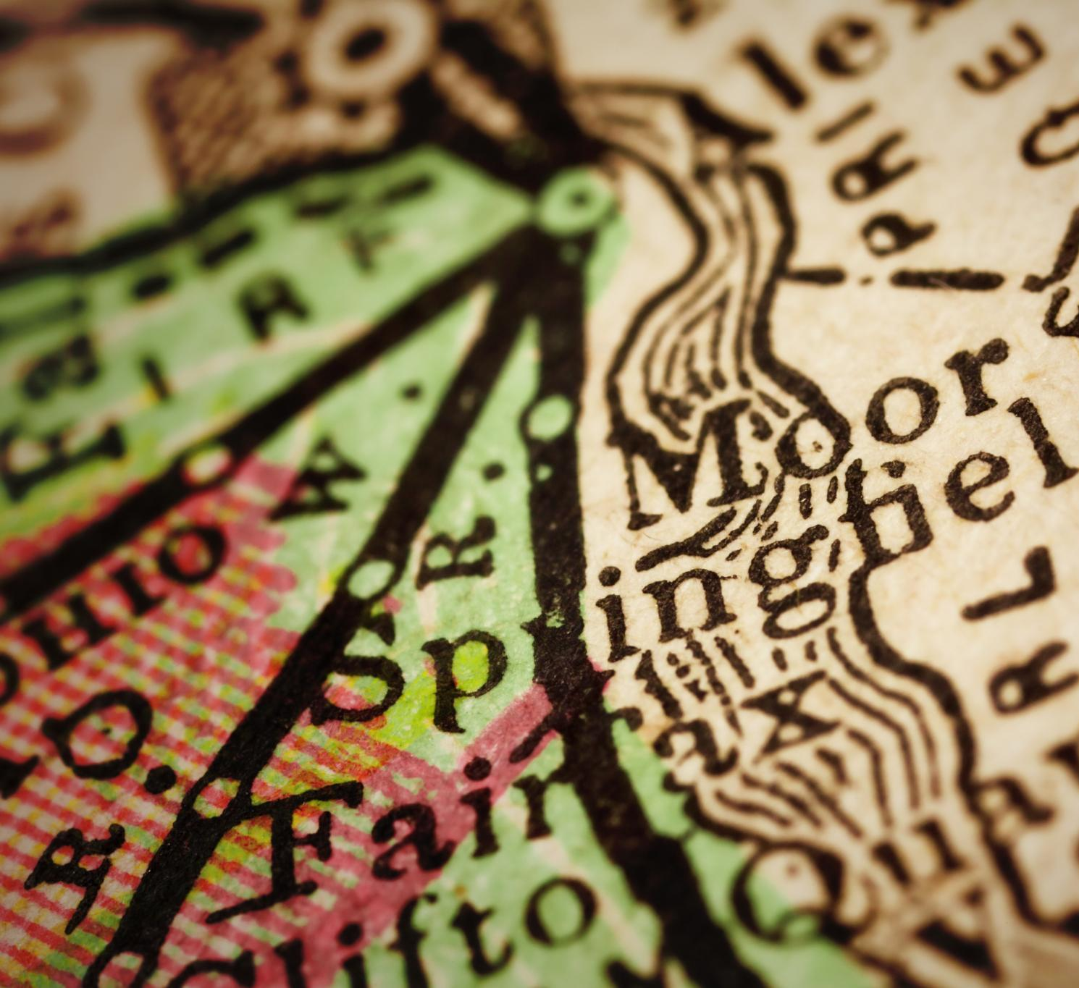
James Monroe's Presidency (1817-1825)
Monroe Doctrine Overview
  The Monroe Doctrine was a key policy statement asserting American influence in the Western Hemisphere.
Impact on Western Hemisphere
  The Monroe Doctrine warned European powers against further colonization and intervention in the Americas, shaping foreign relations.
Notes:
Monroe's presidency is best known for the Monroe Doctrine, which asserted American influence in the Western Hemisphere and warned European powers against further colonization.

Slide 15
Vice Presidents From the Democratic-Republican Party
Notes:
The Democratic-Republican Party also provided several Vice Presidents who played crucial roles in the administration and governance of the early republic.

Slide 16
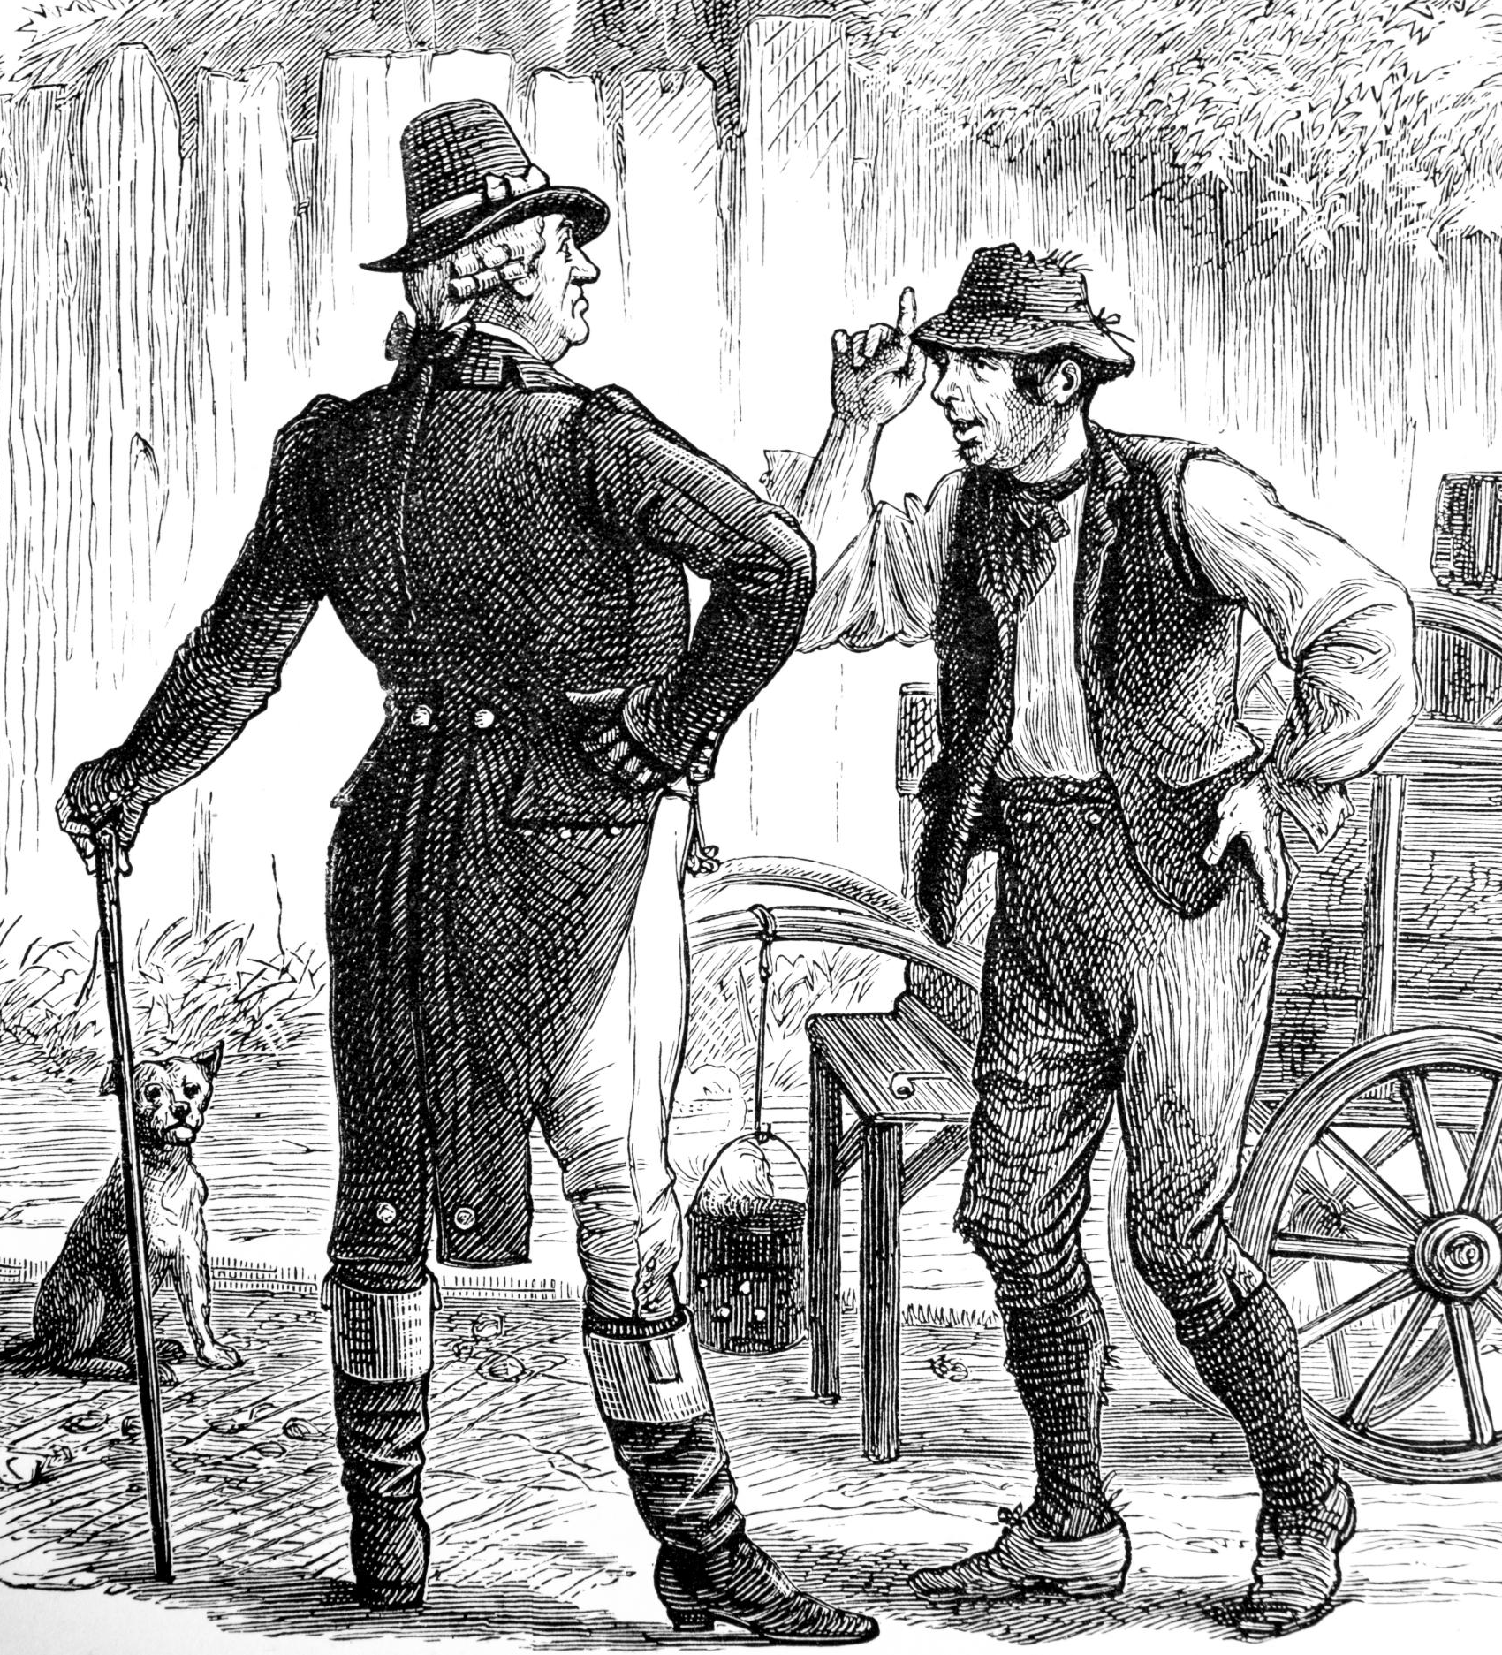
Aaron Burr (1801-1805)
Vice Presidency
  Aaron Burr served as the third Vice President of the United States under Thomas Jefferson from 1801 to 1805.
Controversial Political Career
  Burr's political career was marked by controversy, leading to significant public and political challenges.
Duel with Alexander Hamilton
  The infamous duel with Alexander Hamilton in 1804 ended Burr's political aspirations and changed American history.
Notes:
Aaron Burr served as Vice President under Thomas Jefferson. His controversial political career included the infamous duel with Alexander Hamilton, which ultimately ended his political aspirations.

Slide 17
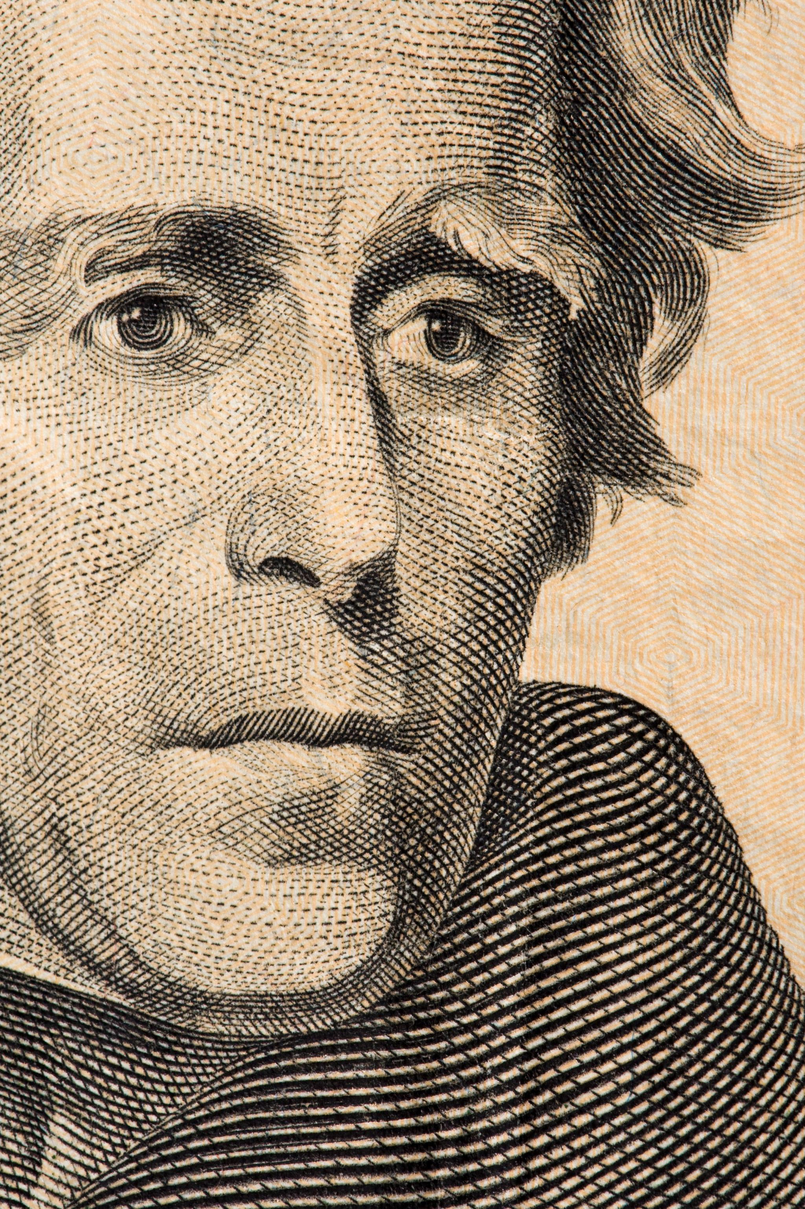
George Clinton (1805-1812)
Vice Presidency
  George Clinton served as Vice President under both Thomas Jefferson and James Madison, playing a key role in early American politics.
States' Rights Advocate
  Clinton was a strong proponent of states' rights, emphasizing the importance of state sovereignty over federal power.
Opposition to Federalist Policies
  Clinton opposed Federalist policies, advocating for a more decentralized government and individual state authority.
Notes:
George Clinton was Vice President under both Jefferson and Madison, known for his strong support of states' rights and opposition to Federalist policies.

Slide 18

Elbridge Gerry (1813-1814)
Role as Vice President
  Elbridge Gerry served as Vice President under James Madison, playing a key role in American governance.
Founding of Democratic-Republican Party
  Gerry was instrumental in the founding of the Democratic-Republican Party, shaping the political landscape of the early republic.
Contributions to Early Republic
  His contributions to the foundations of the early republic were significant in balancing federal and state powers.
Notes:
Elbridge Gerry served as Vice President during Madison's administration, notable for his role in the founding of the Democratic-Republican Party and his contributions to the early republic.

Slide 19
Legacy and Impact of the Democratic-Republican Party
Notes:
The Democratic-Republican Party played a crucial role in shaping early American governance and political discourse. Its principles and leaders influenced subsequent political movements.

Slide 20
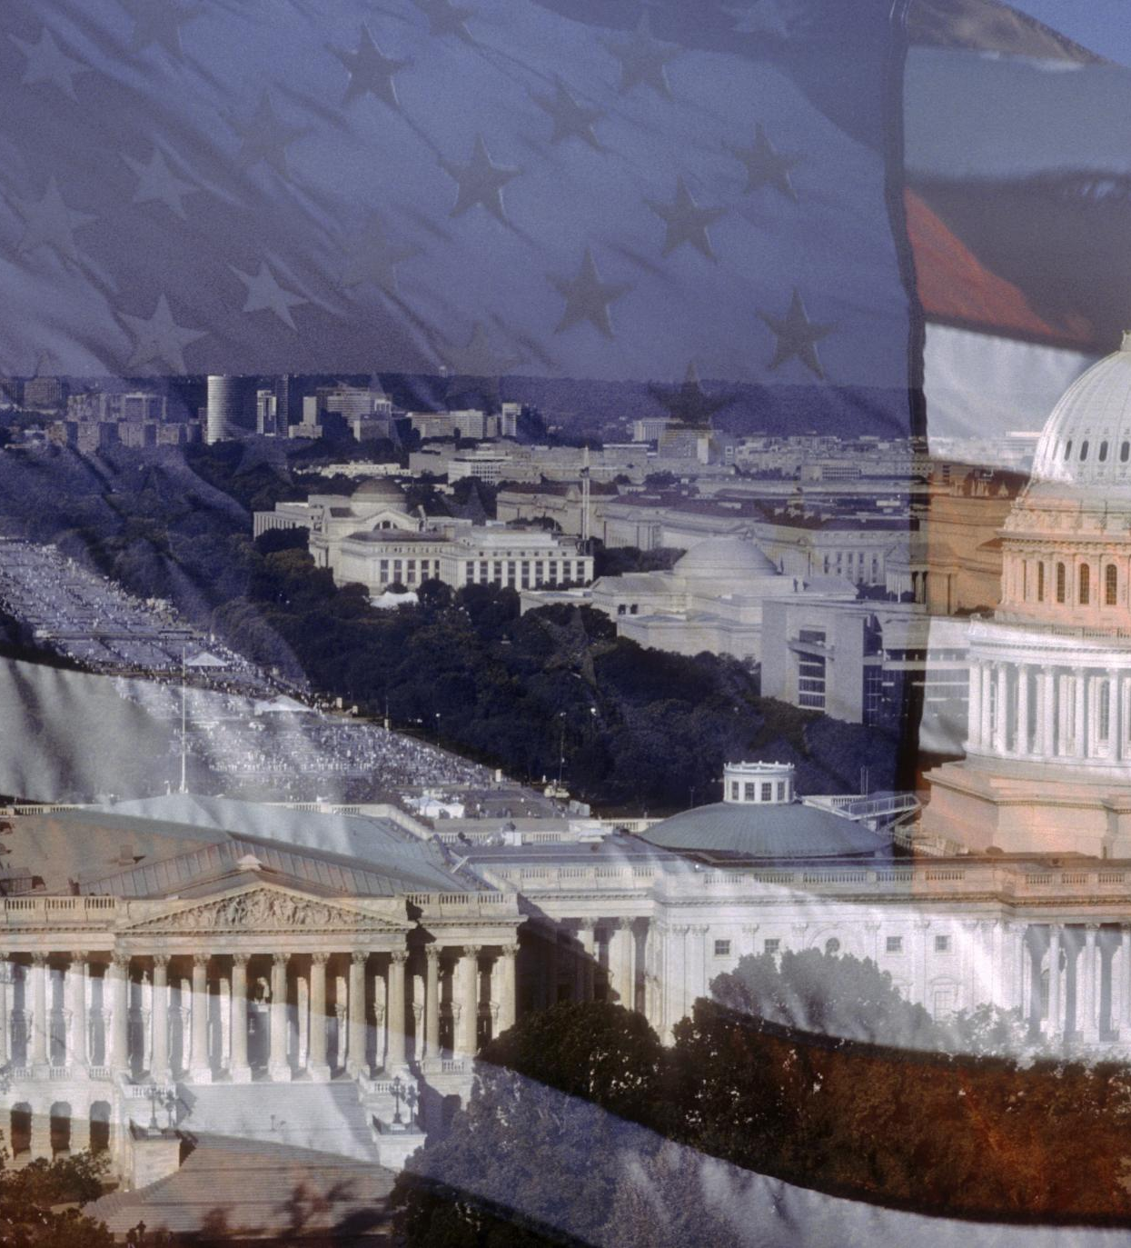
Contributions to American Political Thought
Individual Liberties
  The emphasis on individual liberties has shaped the foundation of American democracy and the protection of personal rights.
States' Rights
  The principle of states' rights emphasizes the role of individual states in governance, contributing to the federal system.
Agrarianism
  Agrarianism has influenced American political thought by promoting the values of rural life and agriculture in policy discussions.
Notes:
The party's emphasis on individual liberties, states' rights, and agrarianism contributed significantly to American political thought and the development of a two-party system.

Slide 21

Influence on Subsequent Political Parties
Foundation of Political Parties
  The Democratic-Republican Party set essential principles that influenced the development of future political parties in the United States.
Key Issues in Politics
  The key issues promoted by the Democratic-Republican Party continue to resonate in contemporary politics and influence party platforms today.
Legacy of the Democratic Party
  The Democratic Party emerged from the Democratic-Republican Party and carries forward its legacy in modern political discourse and governance.
Notes:
The Democratic-Republican Party laid the foundation for future political parties, including the Democratic Party, by promoting key issues that resonate in contemporary politics.

Slide 22
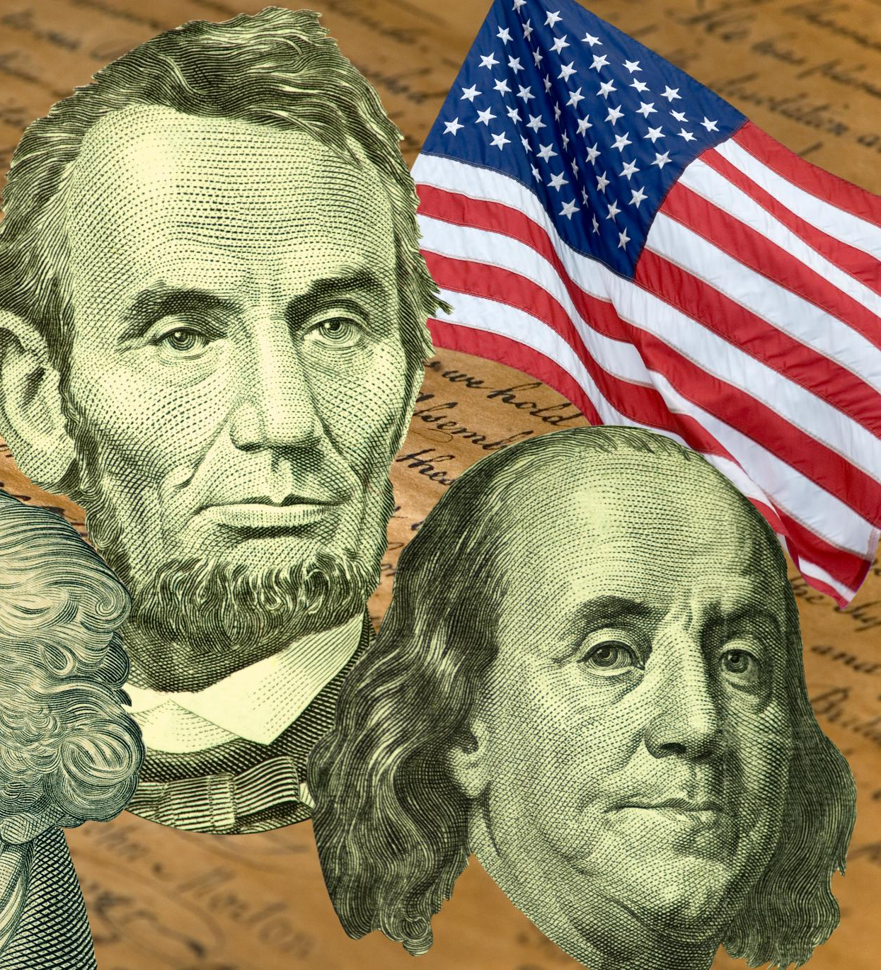
End of the Party and Its Lasting Legacy
Dissolution of the Party
  The gradual dissolution of the Democratic-Republican Party occurred after the War of 1812, resulting in new political factions emerging in the United States.
Emergence of New Factions
  Following the Democratic-Republican Party's decline, new political factions emerged, which reshaped the American political landscape.
Legacy in Political Discourse
  The legacy of the Democratic-Republican Party continues to influence contemporary American political discourse and party ideologies.
Notes:
The Democratic-Republican Party gradually dissolved after the War of 1812, leading to the emergence of new political factions. Nevertheless, its legacy continues to shape American political discourse.

Slide 23
Conclusion
Political Influence
The Democratic-Republican Party played a crucial role in shaping the early political framework of the United States.
Founders and Principles
The party was founded by key figures advocating for a more decentralized government and individual liberties.
Lasting Impact
The ideals and policies of the Democratic-Republican Party continue to resonate in modern American democracy.
Notes:
The Democratic-Republican Party was instrumental in the early political landscape of the United States. Its founders, principles, and lasting impact continue to influence American democracy today.

