Slide 1
The Radical Republicans: Leaders, Beliefs, and Their Revolt Against President Andrew Johnson
Exploring key figures and their historic political resistance
Notes:
---
This presentation explores the Radical Republicans, their leaders and beliefs, and their opposition to President Andrew Johnson during the turbulent Reconstruction era following the Civil War.

Slide 2
Who Were the Radical Republicans?
Notes:
The Radical Republicans were a faction within the Republican Party advocating for harsh Reconstruction measures and full civil rights for African Americans. Their influence shaped Congressional Reconstruction policies.

Slide 3

Key Leaders and Prominent Figures
Radical Republican Leadership
  Radical Republicans were influential leaders advocating for civil rights and rigorous Reconstruction policies.
Civil Rights Advocacy
  These leaders strongly supported civil rights reforms and protection for newly freed African Americans.
Reconstruction Policies
  They pushed for strict terms on Southern states’ readmission to the Union to reshape post-war society.
Notes:
---
Notable Radical Republicans included Thaddeus Stevens, Charles Sumner, and Benjamin Wade. These leaders championed civil rights and strict terms for Southern states' readmission to the Union.
Image source: Microsoft 365 content library

Slide 4
Political Origins and Rise Within the Republican Party
Abolitionist Roots
Radical Republicans originated from abolitionists and anti-slavery advocates committed to ending slavery.
Civil War Influence
Their influence grew during the Civil War as they pushed for stronger federal policies to address slavery and civil rights.
Reconstruction Policies
They advocated for strong federal intervention during Reconstruction to reshape Southern society and protect freedmen's rights.
Notes:
---
The Radical Republicans emerged from abolitionists and anti-slavery advocates. They gained influence during the Civil War and pushed for stronger federal intervention during Reconstruction.
Image source: Microsoft 365 content library

Slide 5

Distinction From Moderate Republicans
Moderate Republicans' Approach
  Moderate Republicans supported leniency and swift reconciliation after the Civil War to restore national unity quickly.
Radical Republicans' Reforms
  Radical Republicans demanded radical reforms including voting rights for African Americans and punitive actions against former Confederates.
Notes:
---
Unlike moderate Republicans who favored leniency and swift reconciliation, Radicals insisted on radical reforms, including voting rights for African Americans and punitive measures against former Confederates.
Image source: Microsoft 365 content library

Slide 6
The Revolt Against President Andrew Johnson
Notes:
Radical Republicans opposed Johnson’s policies, leading to a political struggle characterized by legislative battles and ultimately impeachment proceedings against the president.

Slide 7
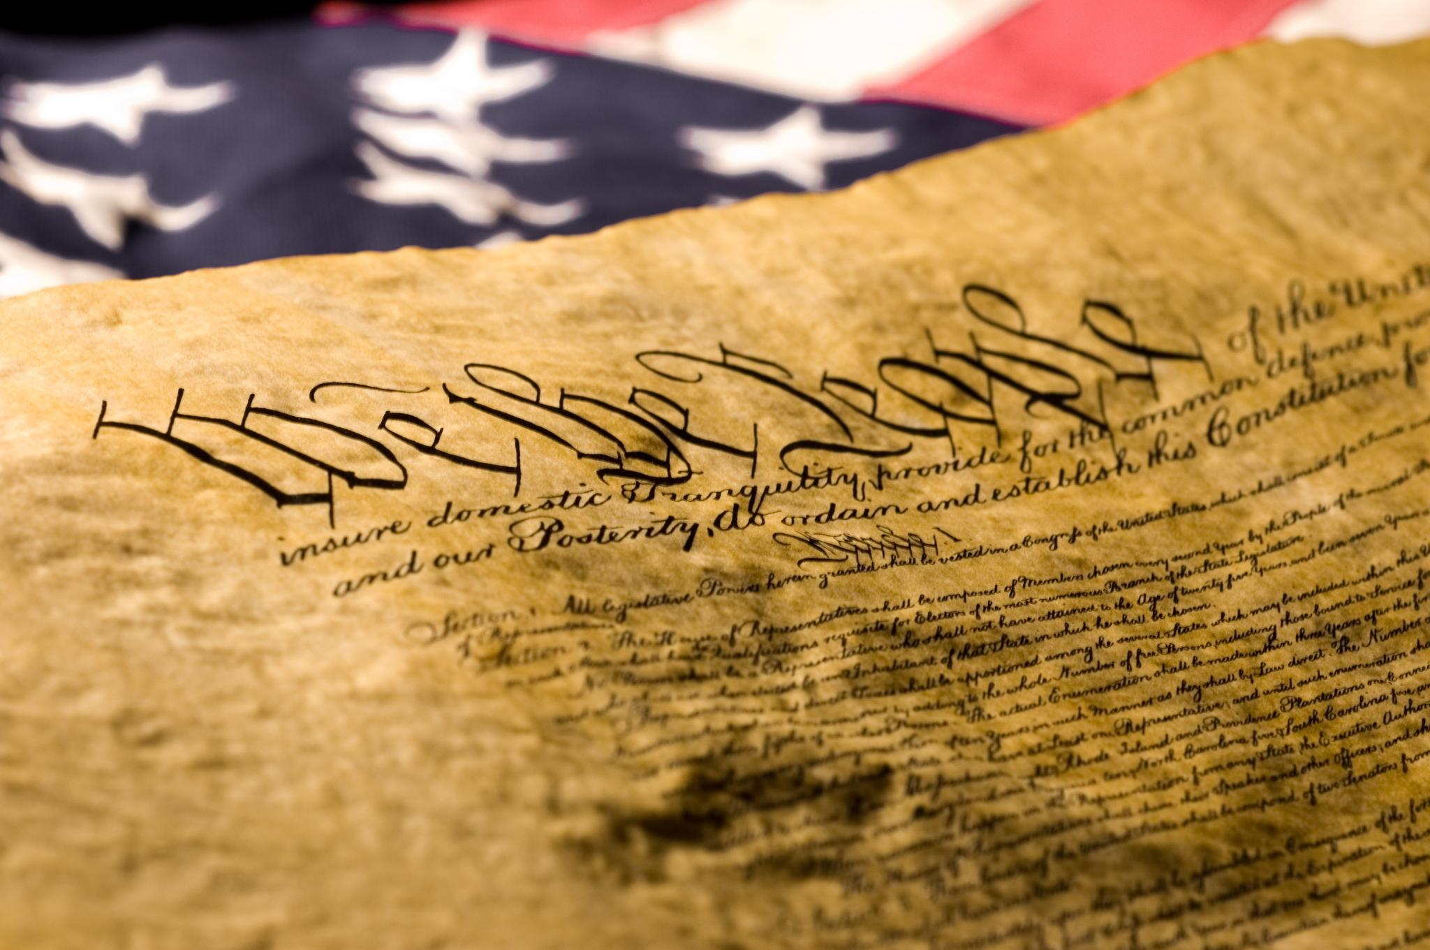
Conflicts over Johnson’s Reconstruction Policies
Criticism of Pardons
  Johnson’s pardons for former Confederates angered radicals who believed it undermined justice and equality.
Vetoes of Civil Rights Legislation
  Johnson vetoed key civil rights laws, prompting fierce opposition from radicals advocating for equality.
Notes:
---
Radicals criticized Johnson's pardons for former Confederates and his vetoes of civil rights legislation, viewing his approach as obstructive to equality and justice.
Image source: Microsoft 365 content library

Slide 8
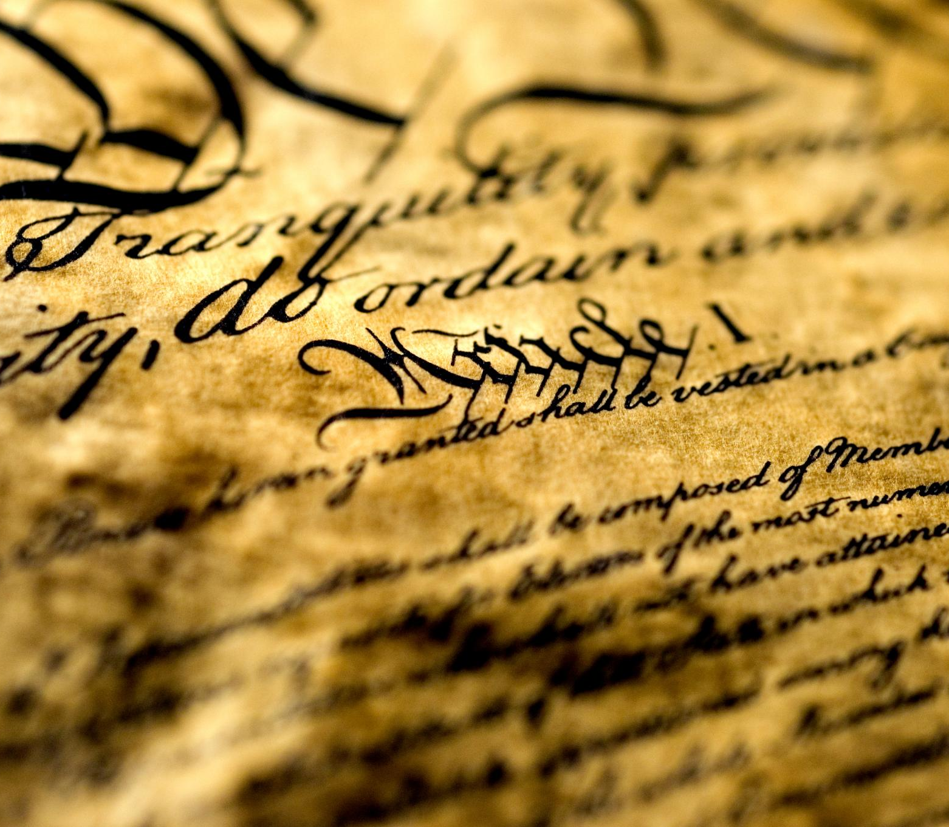
Efforts to Limit Presidential Power: The Tenure of Office Act
Purpose of the Act
  The Tenure of Office Act was designed to limit the president's power to remove appointed officials without Senate approval.
Conflict with Radical Republicans
  The Act intensified the struggle between President Johnson and Radical Republicans in Congress during Reconstruction.
Notes:
---
Congress passed the Tenure of Office Act to restrict Johnson's ability to remove certain officeholders. This law was a key tool in the conflict between Johnson and Radical Republicans.
Image source: Microsoft 365 content library

Slide 9
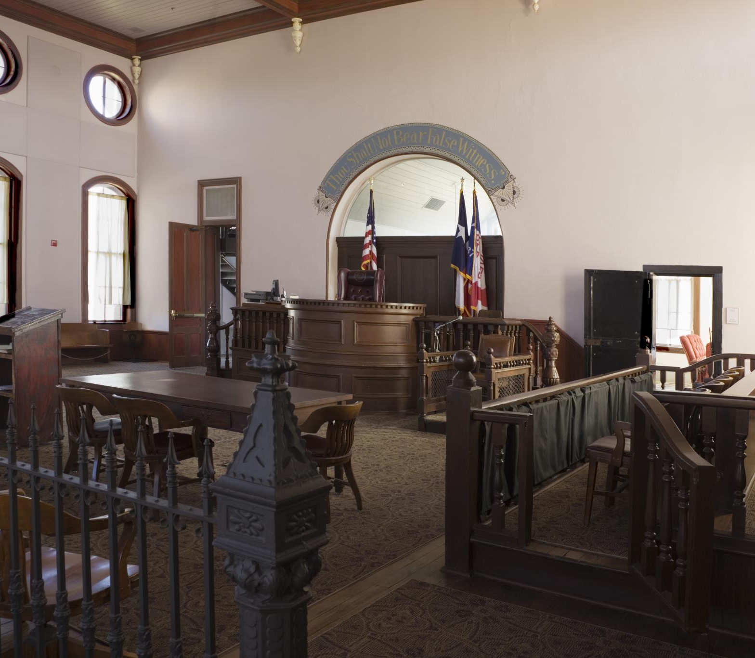
The Impeachment of Andrew Johnson and Its Aftermath
Cause of Impeachment
  Johnson was impeached for violating the Tenure of Office Act by removing a cabinet member without Senate approval.
Impeachment Trial Outcome
  Johnson narrowly avoided removal from office, surviving by a single Senate vote, highlighting political tensions.
Political Division Impact
  The impeachment underscored deep political divisions during the Reconstruction era in the United States.
Notes:
---
Johnson was impeached in 1868 over his violation of the Tenure of Office Act. He narrowly avoided removal from office, but the impeachment underscored the deep political divisions of the era.
Image source: Microsoft 365 content library

Slide 10
Legacy and Impact of the Radical Republicans
Notes:
The Radical Republicans left a lasting impact on Reconstruction policies and civil rights, though their legacy is debated among historians regarding successes and failures.

Slide 11

Long-Term Effects on Reconstruction
Advancements in Political Participation
  Radical Reconstruction policies increased African American political involvement and representation significantly during the period.
Civil Rights Progress
  Significant civil rights improvements were made, promoting equality and legal protections for African Americans.
Rollback After 1877
  Many advances were reversed following the end of Reconstruction, limiting political and civil rights progress.
Notes:
---
Radical policies led to significant but temporary advancements in African American political participation and civil rights during Reconstruction, though many gains were rolled back after 1877.
Image source: Microsoft 365 content library

Slide 12

Influence on Civil Rights Legislation
14th Amendment Impact
  The 14th Amendment guaranteed citizenship to all persons born or naturalized in the United States, ensuring equal protection under the law.
15th Amendment Significance
  The 15th Amendment secured voting rights regardless of race, laying the foundation for future civil rights movements.
Notes:
---
Radicals championed the 14th and 15th Amendments, which guaranteed citizenship and voting rights regardless of race, foundational for later civil rights movements.
Image source: Microsoft 365 content library

Slide 13

Historical Evaluation of Their Successes and Failures
Strides for Equality
  Radical Republicans achieved significant progress advancing civil rights and equality during Reconstruction.
Resistance and Challenges
  Their efforts faced strong opposition and resistance from various groups hindering enforcement.
Mixed Legacy
  The legacy of Radical Republicans is mixed, featuring both important progress and significant setbacks.
Notes:
---
While Radical Republicans made profound strides for equality, their efforts faced fierce resistance and limited long-term enforcement, resulting in a mixed legacy of progress and setbacks.
Image source: Microsoft 365 content library

