Slide 1
The Whig Party in the U.S.: History, Ideology, and Key Figures
Exploring the impact of a pivotal political party
Notes:
AI-generated content may be incorrect. --- The Whig Party played a significant role in American politics in the 19th century. In this presentation, we will explore its origins, political platform, prominent figures, and notable leaders.

Slide 2
Agenda of Discussion
Origins and Timeline of the Whig Party
Political Platform and Ideology
Prominent Figures of the Whig Party
Presidents and Vice Presidents From the Whig Party
Notes:
We will begin with the origins and timeline of the Whig Party, tracing its founding, rise, decline, and eventual dissolution. Next, we will examine its political platform and ideology, including its economic policies and key issues. Finally, we will highlight prominent figures of the Whig Party and the presidents and vice presidents who represented the party.

Slide 3
Origins and Timeline of the Whig Party
Notes:
The Whig Party emerged in the early 1830s as a response to the policies of President Andrew Jackson and the Democratic Party. Understanding its historical context is crucial to grasping its influence on American politics.

Slide 4

Founding of the Whig Party
Coalition of Factions
The Whig Party emerged from a coalition of former National Republicans and anti-Jacksonian Democrats, highlighting political unity.
Opposition to Jackson
The party's formation was a direct response to what they perceived as Jackson's autocratic rule and governance style.
Formation of the Party
The establishment of the Whig Party marked a significant shift in the political landscape of the time.
Notes:
The Whig Party was founded as a coalition of various political factions, including former National Republicans and anti-Jacksonian Democrats. Its formation aimed to oppose what they viewed as Jackson's autocratic rule.

Slide 5
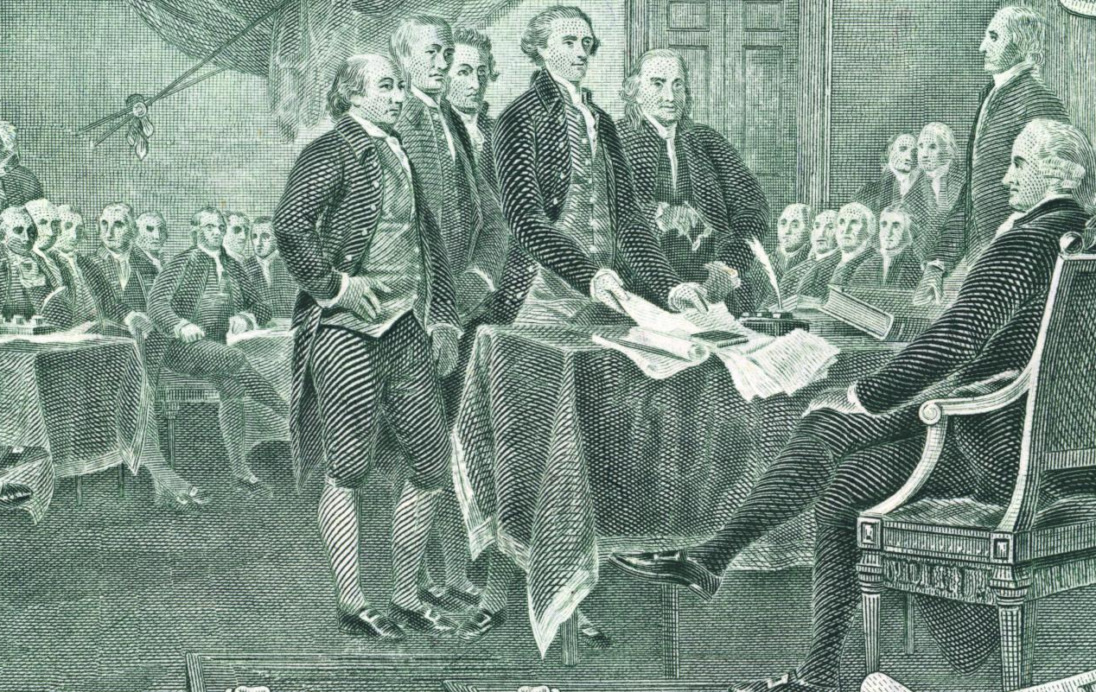
Rise and Decline
Success in the 1840s
The Whig Party achieved significant electoral success in the 1840s, notably winning the presidency with William Henry Harrison in 1840.
Divisions within the Party
Internal divisions over issues like slavery created significant challenges for the Whig Party, contributing to its weakening.
Decline in the 1850s
By the 1850s, the Whig Party faced a steep decline due to its inability to unify on crucial issues, leading to its eventual dissolution.
Notes:
The Whig Party experienced significant success in the 1840s, winning the presidency with William Henry Harrison in 1840. However, internal divisions over slavery and other issues led to its decline in the 1850s.

Slide 6

Dissolution and Aftermath
Whig Party Dissolution
By the late 1850s, the Whig Party had effectively dissolved, leading to a major shift in American politics.
Formation of the Republican Party
Many former Whig members joined the newly formed Republican Party, changing the political landscape significantly.
Political Transformation
This shift from the Whig Party to the Republican Party marked a significant transformation in American politics.
Notes:
By the late 1850s, the Whig Party had effectively dissolved, with many members joining the newly formed Republican Party. This shift marked a significant transformation in the American political landscape.

Slide 7
Political Platform and Ideology
Notes:
The Whig Party was characterized by a diverse political platform that sought to address various economic and social issues of the time. Understanding their ideology helps contextualize their policies and initiatives.

Slide 8

Economic Policies
Role of Government
The Whigs believed in a strong government role to stimulate economic growth and support American industry.
Infrastructure Development
Support for infrastructure projects was key to enabling trade and economic expansion during the Whig era.
National Bank
The establishment of a national bank was proposed to stabilize the economy and provide reliable currency for trade.
Protective Tariffs
Protective tariffs were supported to shield American industries from foreign competition and promote domestic manufacturing.
Notes:
The Whigs advocated for a strong role of government in the economy, supporting policies such as infrastructure development, a national bank, and protective tariffs to promote American industry.

Slide 9
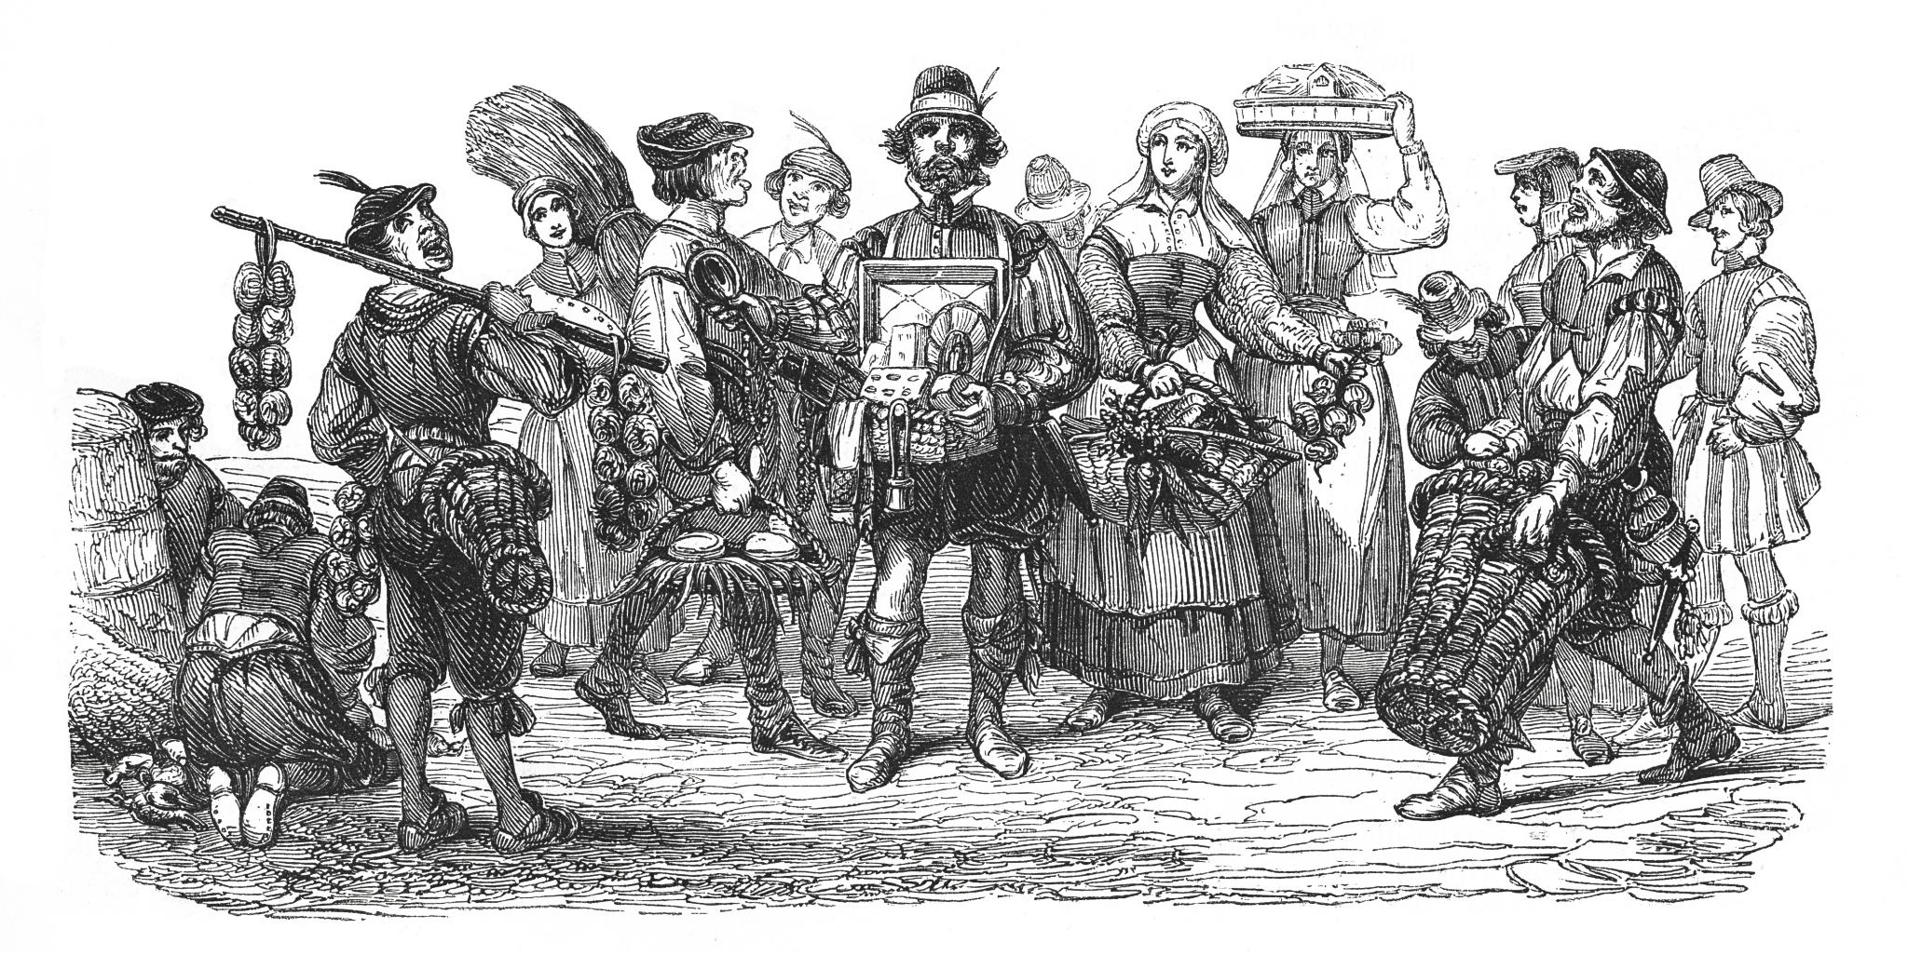
Social and Political Beliefs
Support for Moral Reforms
The Whig Party championed moral reforms, advocating for a society guided by ethical principles and civic responsibility.
Advocacy for Education
Education was a key focus for the Whig Party, as they believed in its power to uplift society and foster informed citizens.
Temperance Movement Support
The Whig Party also supported the temperance movement, seeking to reduce alcohol consumption for a healthier society.
Notes:
The Whig Party held a range of social and political beliefs, including support for moral reforms, education, and the temperance movement. They aimed to create a more orderly and prosperous society.

Slide 10

Key Issues and Legislative Initiatives
Opposition to Expansion
The Whigs opposed territorial expansion that lacked proper governance, emphasizing the need for responsible governance over new territories.
Support for Internal Improvements
The Whigs championed internal improvements, advocating for infrastructure development to enhance economic growth and connectivity.
Focus on Economic Development
Economic development was a priority for the Whigs, reflecting their commitment to fostering a prosperous and stable economy.
Notes:
Key issues for the Whigs included opposition to territorial expansion without adequate governance, support for internal improvements, and a focus on economic development. Their legislative initiatives reflected these priorities.

Slide 11
Prominent Figures of the Whig Party
Notes:
Throughout its history, the Whig Party was shaped by several influential figures who played key roles in its development and political strategies. Their contributions were significant in shaping the party's legacy.

Slide 12

Henry Clay: The Great Compromiser
Role in the Whig Party
Henry Clay was a prominent leader within the Whig Party, shaping its policies and direction during critical moments in American history.
Compromise on Tariffs
Clay's ability to negotiate compromises on tariffs helped to ease economic tensions between different regions of the country.
Stance on Slavery
He brokered important compromises regarding slavery, attempting to maintain the Union amidst growing sectional tensions.
Notes:
Henry Clay was a central figure in the Whig Party, known for his ability to broker compromises on contentious issues such as tariffs and slavery. His leadership helped to navigate the party through turbulent times.

Slide 13

Daniel Webster: Leading Orator
Prominent Statesman
Daniel Webster was a leading figure in American politics, representing the Whig Party's interests during his career.
Eloquent Orator
Webster was renowned for his powerful oratory skills, delivering speeches that captured the attention of Congress and the nation.
Whig Party Advocate
His advocacy helped shape the Whig Party's policies on national issues, influencing American political discourse.
Notes:
Daniel Webster was a prominent statesman and orator who advocated for the Whig Party's policies. His eloquent speeches and debates in Congress helped define the party’s stance on national issues.

Slide 14

John Quincy Adams: Former President and Whig Supporter
Support for the Whig Party
John Quincy Adams, although not a founder, supported the Whig Party after his presidency, influencing its direction and policies.
Civil Liberties Advocate
Adams was a strong proponent of civil liberties, emphasizing the importance of individual rights and freedoms in American society.
Opposition to Slavery
Adams played a crucial role in the anti-slavery movement, opposing the practice and fighting for the rights of enslaved individuals.
Notes:
Although not a Whig Party founder, John Quincy Adams supported the party after his presidency. He played a significant role in its ideology, particularly concerning issues of civil liberties and opposition to slavery.

Slide 15
Presidents and Vice Presidents From the Whig Party
Notes:
The Whig Party produced several presidents and vice presidents who made significant contributions to American politics. Their presidencies were marked by both achievements and notable challenges.

Slide 16

William Henry Harrison
First Whig President
William Henry Harrison was the first president from the Whig Party, marking a significant shift in American politics.
Brief Tenure
His presidency was notably short, lasting only one month before his untimely death in office.
Campaign Slogan
The slogan 'Tippecanoe and Tyler Too' highlighted the populist appeal of his campaign and resonated with the public.
Notes:
William Henry Harrison was the first Whig president, known for his brief tenure marked by his death just a month after taking office. His campaign slogan 'Tippecanoe and Tyler Too' symbolizes the party's populist appeal.

Slide 17
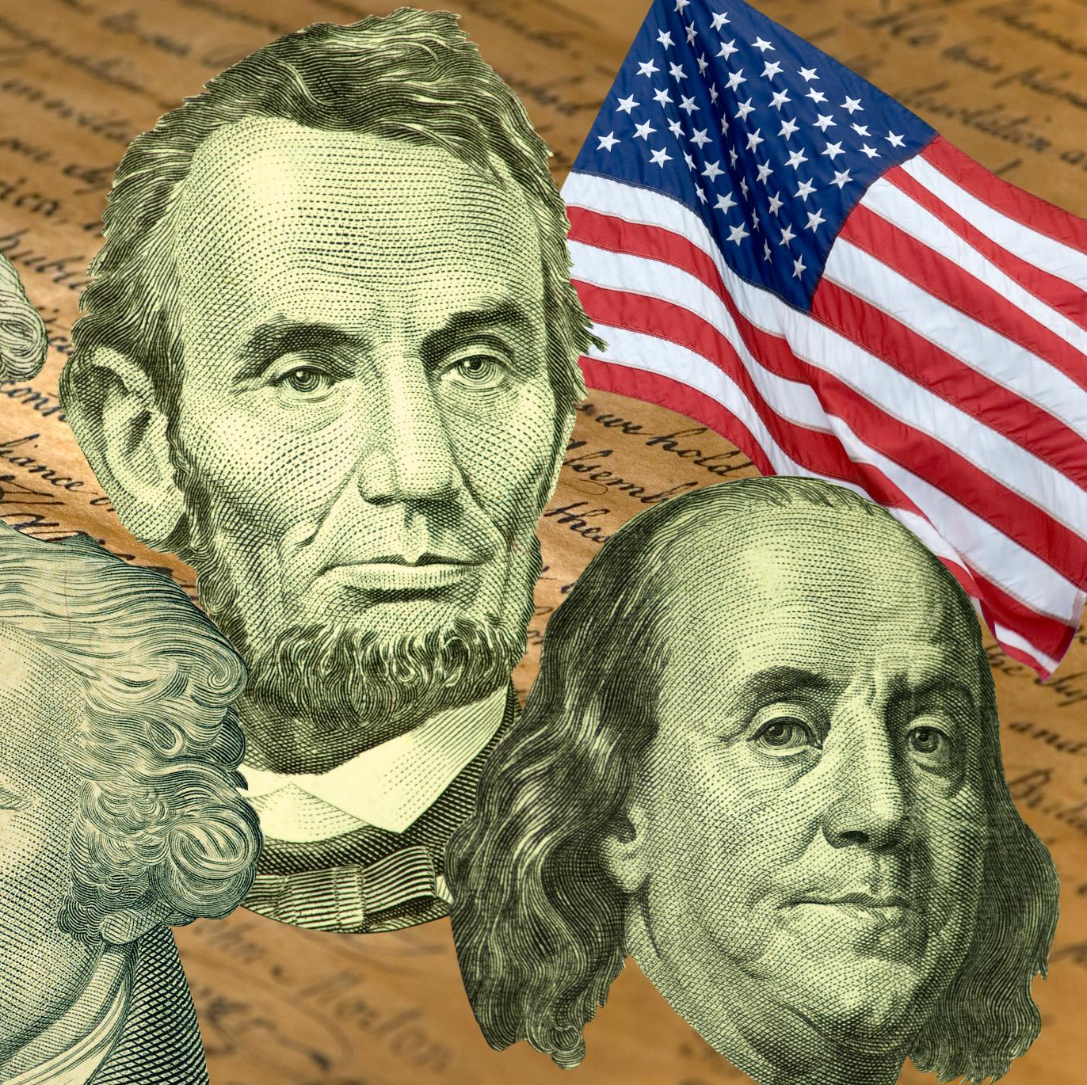
John Tyler
Succession and Political Struggles
John Tyler succeeded William Henry Harrison, facing immediate challenges and political struggles within the Whig party.
Whig Party Clashes
Tyler's frequent clashes with Whig leadership created significant tensions that contributed to the party's decline.
Controversial Presidency
Tyler's presidency was marked by several controversies, shaping his legacy and the political landscape of the time.
Notes:
John Tyler succeeded Harrison and was initially a Whig, but he often clashed with the party leadership, leading to tensions that contributed to the party's decline. Tyler’s presidency was marked by significant controversies.

Slide 18

Zachary Taylor and Millard Fillmore
Zachary Taylor's Presidency
Zachary Taylor was a military hero who became the Whig president but died in office just 16 months into his term.
Millard Fillmore's Succession
Millard Fillmore, Taylor's vice president, took office and faced significant national tensions regarding slavery and the Union's integrity.
Compromise of 1850
The Compromise of 1850 was a series of legislative measures aimed at addressing the divisive issue of slavery in the United States.
Notes:
Zachary Taylor, a military hero, served as the Whig president before his death in office. Millard Fillmore, his vice president, succeeded him and faced the challenges of the Compromise of 1850, which sought to address tensions over slavery.

Slide 19
Conclusion
Role of the Whig Party
The Whig Party was instrumental in shaping 19th-century American politics, influencing major political shifts and events.
Diverse Ideology
The diverse ideology of the Whig Party encompassed various political beliefs, contributing to its unique place in American history.
Prominent Figures
The Whig Party was home to many prominent figures who played significant roles in shaping policies and political discourse.
Lasting Impacts
The Whig Party's initiatives have had lasting impacts on the political landscape of the United States, influencing future parties and policies.
Notes:
The Whig Party played a crucial role in shaping American politics in the 19th century. Its diverse ideology, prominent figures, and significant political initiatives reflect a pivotal era in U.S. history, with lasting impacts on the political landscape.

